Slide 1
The Stagnant Seventies
America Screeches to a Halt

Slide 2
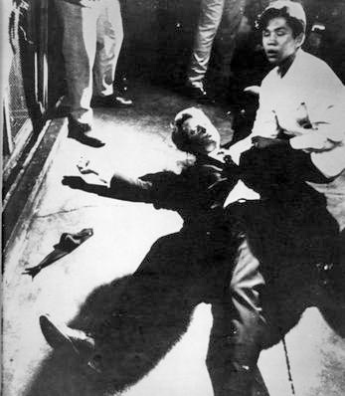
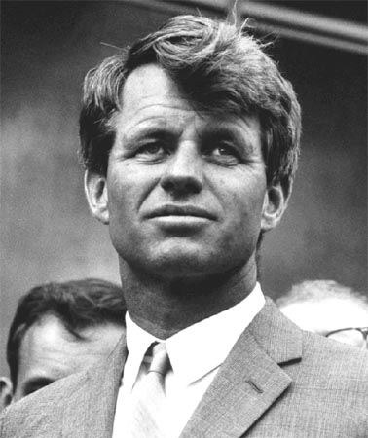
Election of 1968
Notes:
Two months after death of MLK

Slide 3
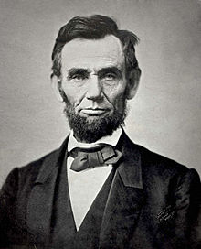
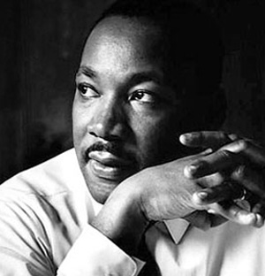
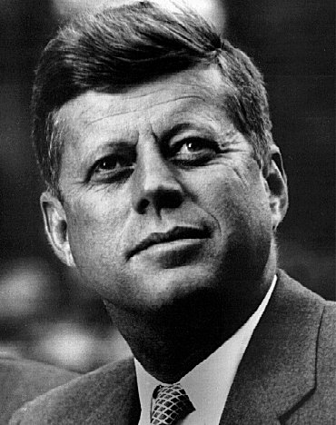
Abraham, Martin, and John - Dion
Notes:
https://www.youtube.com/watch?v=ZBiH5fsKJB8
HIPP the song:
When did this occur?
Who was this for?
What is the message/main point of this song?
How does Dion feel about these events? Why did he write a song about them?

Slide 4
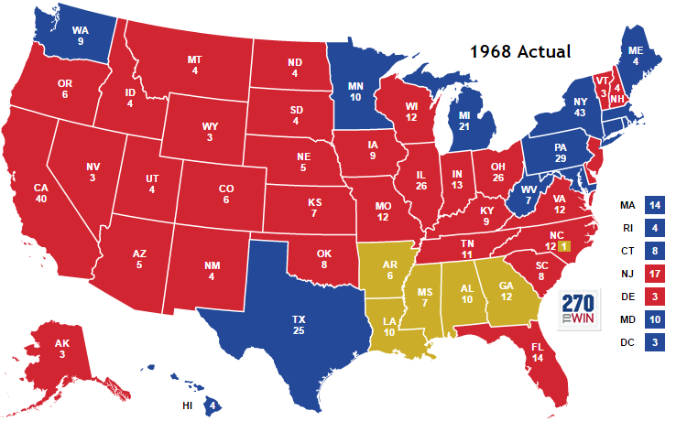
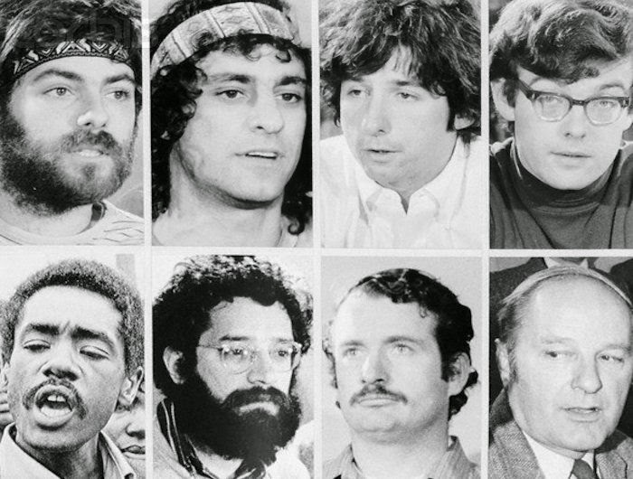
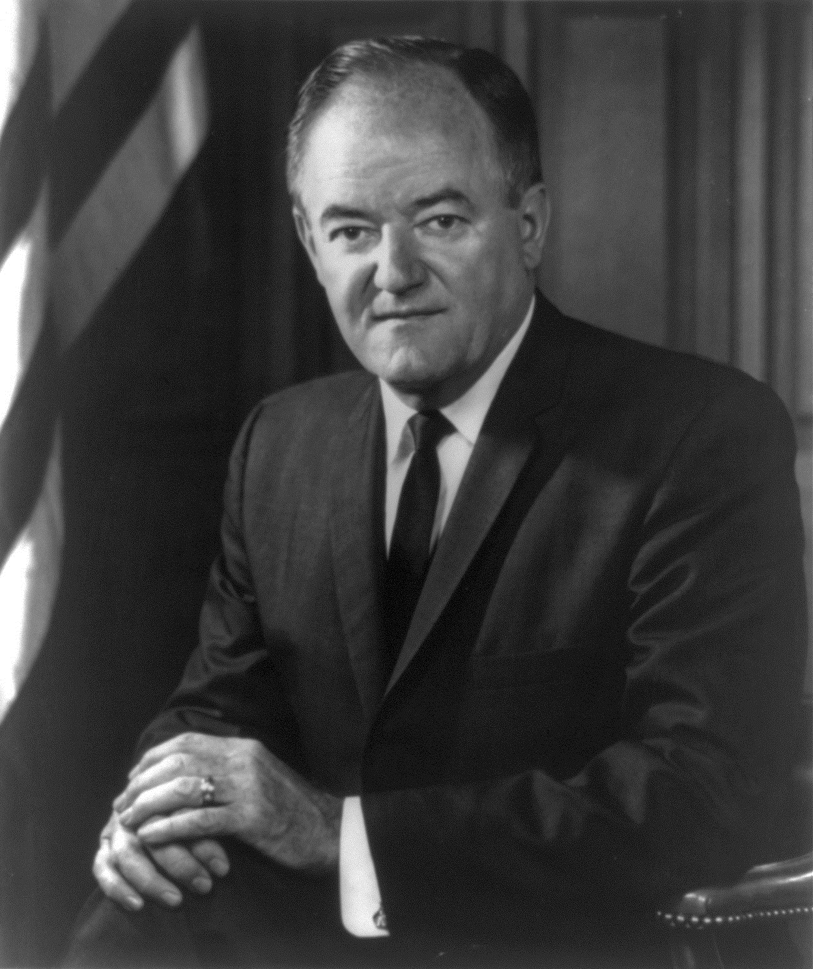
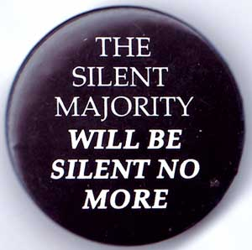
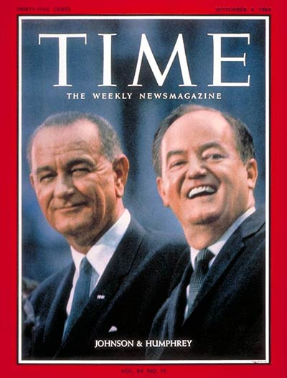
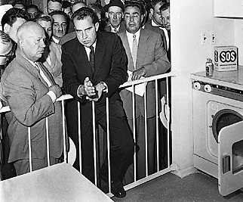
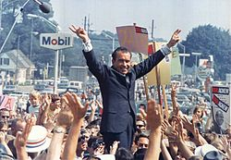
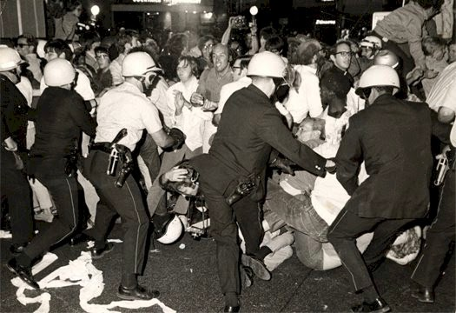
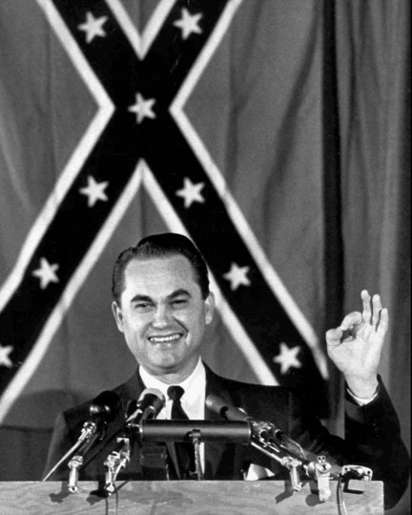
Election of 1968
I am not a crook.
AMERICAN INDEPENDENT
REPUBLICANS
DEMOCRATS
Segregation now, segregation tomorrow, segregation forever!
Notes:
Democrats
Bobby Kennedy expected winner of Democratic nomination; Assassinated after winning CA primary
JFK’s younger brother, Bobby, ran for the Democratic Party’s Presidential nomination.
At a campaign rally in Indianapolis, Bobby had the unfortunate duty to inform the crowd of the assassination of MLK
Two months later, he too would be fatally shot after winning the CA primary.
Battle of Michigan Avenue – 1968 DNC Riot
Chicago Seven
On this day in 1968, at the Democratic National Convention in Chicago, tens of thousands of Vietnam War protesters battle police in the streets, while the Democratic Party falls apart over an internal disagreement concerning its stance on Vietnam. Over the course of 24 hours, the predominant American line of thought on the Cold War with the Soviet Union was shattered.
seven defendants—Abbie Hoffman, Jerry Rubin, David Dellinger, Tom Hayden, Rennie Davis, John Froines, and Lee Weiner—charged by the federal government with conspiracy, inciting to riot, and other charges related to anti-Vietnam War and countercultural protests that took place
Democrats nominates VP Hubert Humphrey
Republicans
Nominate former VP Richard Nixon
“Checkers Speech” and “Kitchen Debate”
The “Checkers Speech”: Senator Nixon was accused of misusing funds established by his backers to reimburse him for his political expenses. He delivered a half-hour television address in which he defended himself and attacked his opponents in hopes of remaining on the ticket for VP. During the speech, he stated that regardless of what anyone said, he intended to keep one gift: a black-and-white dog who had been named Checkers by the Nixon children, thus giving the address its popular name.
The Kitchen Debate was an intense discussion between VP Nixon and Nikita Khrushchev at the opening of the American National Exhibition in Moscow in 1959. For the exhibition, an entire house was built that the American exhibitors claimed anyone in America could afford. It was filled with labor-saving and recreational devices meant to represent the fruits of the capitalist American consumer market. The debate was recorded on color videotape, a new technology pioneered in the U.S., and Nixon made reference to this fact; it was subsequently rebroadcast in both countries.
“Silent Majority”: Nixon’s reference to voters whose voices were drowned out by protests by liberal youth.
Made up of WWII vets, young people in the Midwest, South, and West, suburbs, blue-collar whites
Not particularly conservative politically, but resented what they saw as disrespect for American institutions
American Independent
George Wallace, Governor of Alabama
Segregationist, anti-civil rights agenda

Slide 5
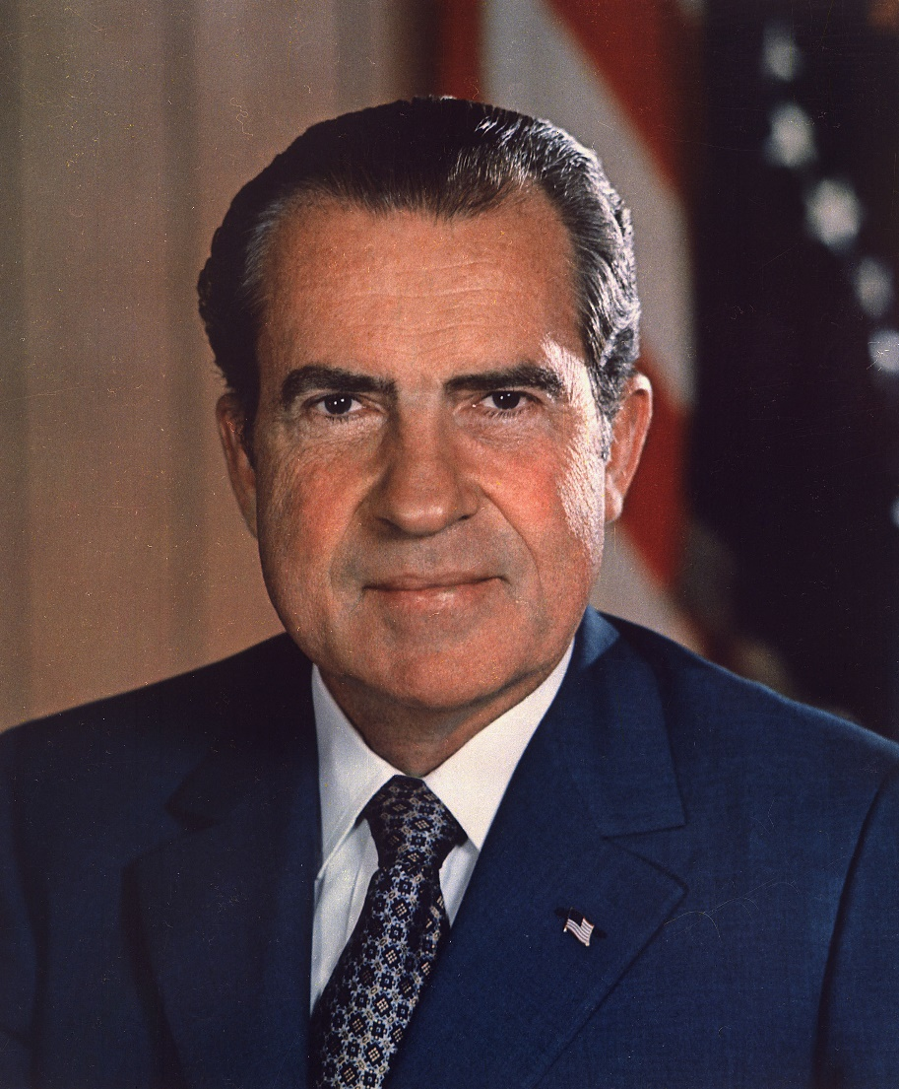
The Nixon Years

Slide 6
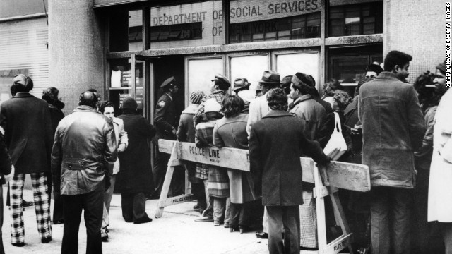
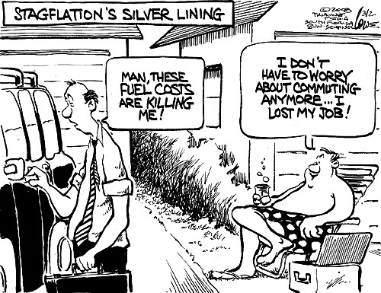
STAGFLATION IN THE SEVENTIES
Stagflation: Stagnation + Inflation
Causes
Increase in spending but not increasing taxes
Decline in manufacturing and GDP
International competition
Nixon takes U.S. off the gold standard
Inflation
Unemployment
Stagnant or declining economy
Notes:
Stagflation: Stagnation + Inflation
High inflation, slow economic growth, high unemployment
Causes
Increase in spending but not increasing taxes (Great Society & Vietnam)
Decline in manufacturing and GDP
International competition
Nixon takes U.S. off the gold standard

Slide 7
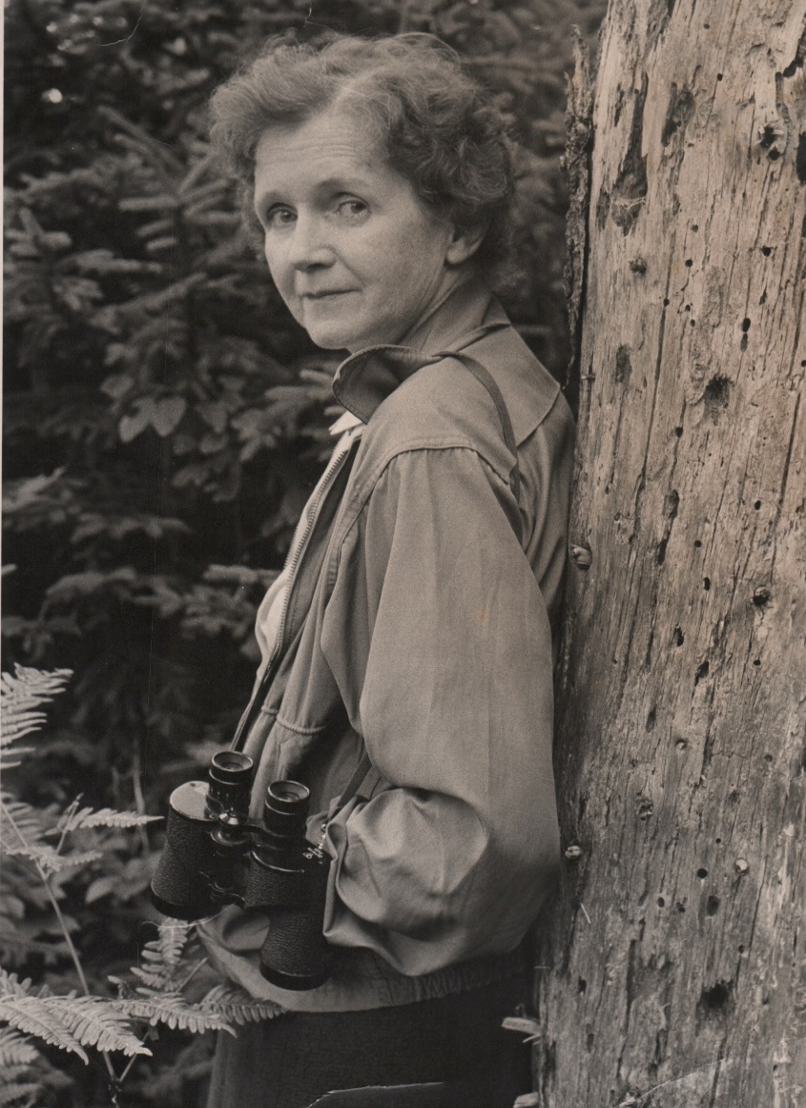
Tree-Huggers Unite!
Rachel Carson: Wrote Silent Spring (1962) which exposed the poisonous effects of pesticides, e.g. DDT
Clean Air Act (1963)
Environmental Protection Agency (EPA, 1970)
Earth Day (1970)
Endangered Species Act (1973)
Notes:
Earth Day is observed on April 22, and is celebrated in more than 192 countries every year.
Earth Day was founded by United States Senator Gaylord Nelson as an environmental teach-in first held on April 22, 1970.
Earth Day 2016: Fri. April 22

Slide 8
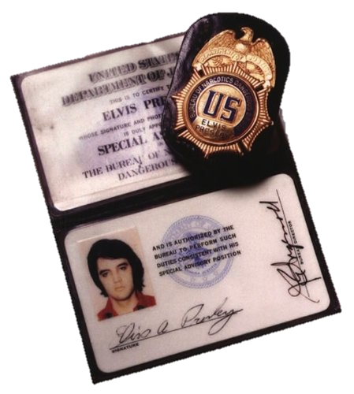
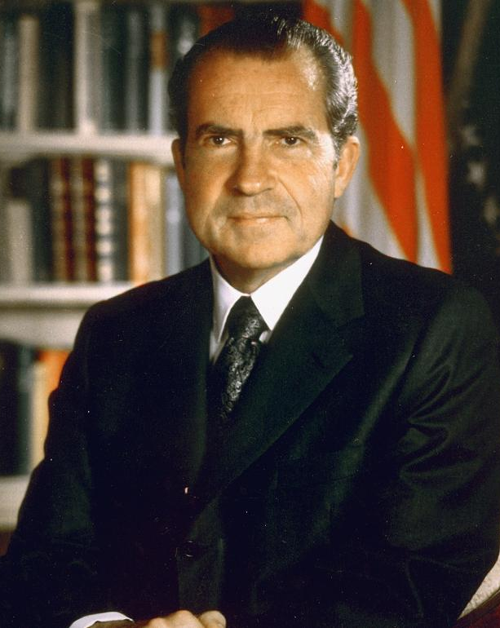
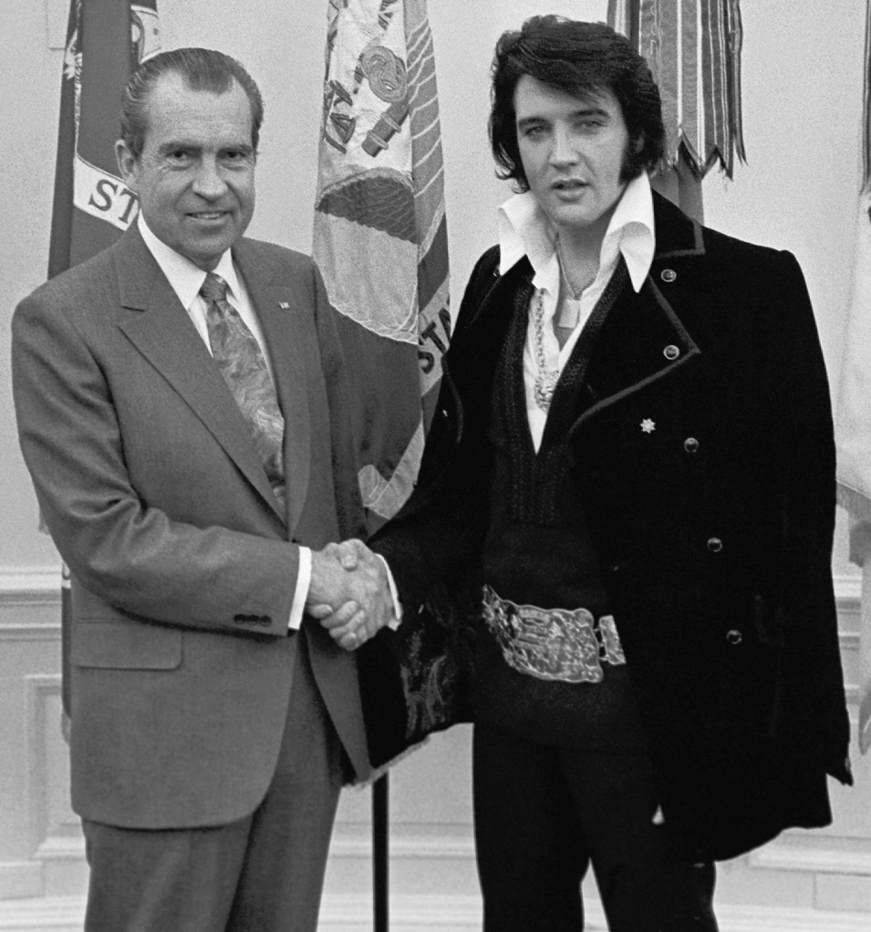
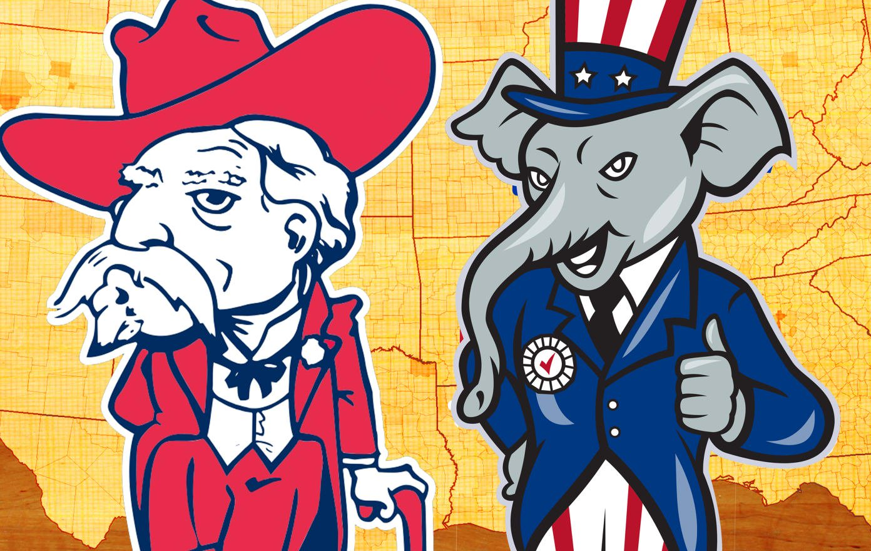
Nixon’s Re-election strategy
Desegregation Busing conflict
War on Drugs
Directed toward eradication of trade and incarceration of dealers and abusers
Drug Enforcement Adminsitration (DEA)
“Southern Strategy”
Appealed to conservative white southerners
Promised to be “tough on crime”
Break up the “Solid South”
"I am convinced that while legal segregation is totally wrong, forced integration of housing or education is just as wrong."
Notes:
Nixon’s “Southern Strategy”: Designed to appeal to conservative white southerners, who traditionally voted Democratic, but were against the civil rights movement
The "Solid South" had voted Democrat since before the Civil War (slavery and segregation)
Disillusioned after Civil Rights Act of 1964
Nixon exploited racial conflict to get the Southern vote
Desegregation Busing: practice of assigning and transporting students to schools so as to redress prior racial segregation of schools, or to overcome the effects of residential segregation on local school demographics.
Caused by white-flight
Swann v. Charlotte-Mecklenburg Board of Education: Supreme Court ruled that the federal courts had the discretion to include busing as a desegregation tool to achieve racial balance. While the Swann decision addressed de jure segregation in the South, it failed to address de facto segregation which persisted elsewhere in the country.
War on Drugs: A campaign, led by the U.S. federal government, with the stated aim being to reduce the illegal drug trade in the United States. The initiative includes a set of drug policies that are intended to discourage the production, distribution, and consumption of illegal drugs
Coined after Nixon declared drug abuse "public enemy number one“
directed toward eradication, interdiction, and incarceration

Slide 9
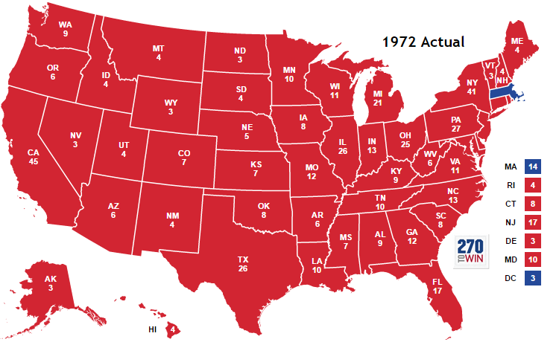
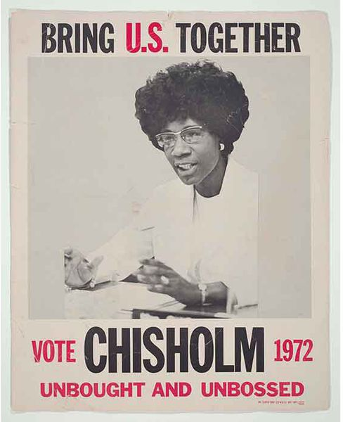
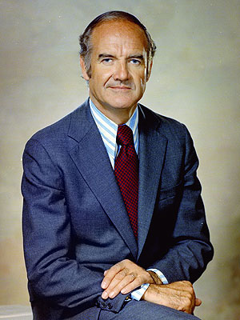
Election of 1972
Democrats
Republicans
Notes:
Shirley Chisolm (D): First African American to run for a major party nomination
Richard Nixon (R) v. George McGovern (D, SD)
McGovern ran an anti-war campaign, but was handicapped by his outsider status and firing of VP nominee
Nixon won 520 to 17 Electoral votes

Slide 10
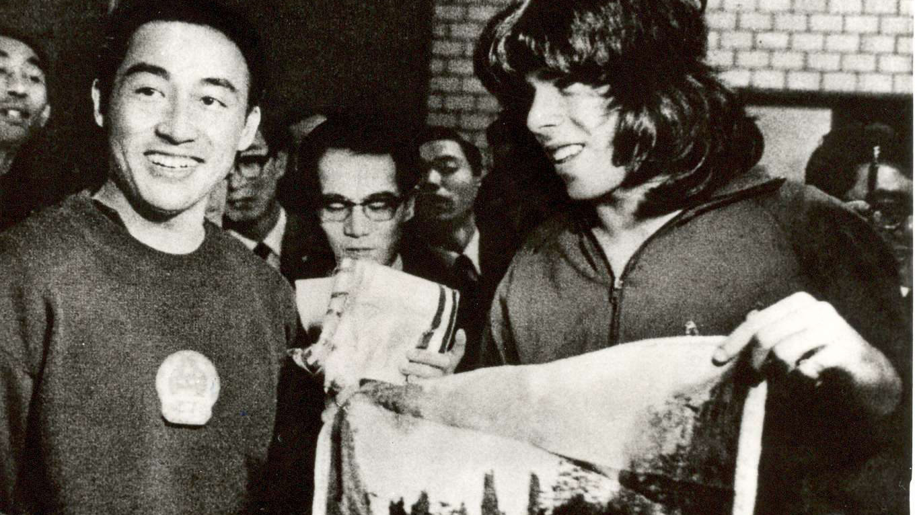
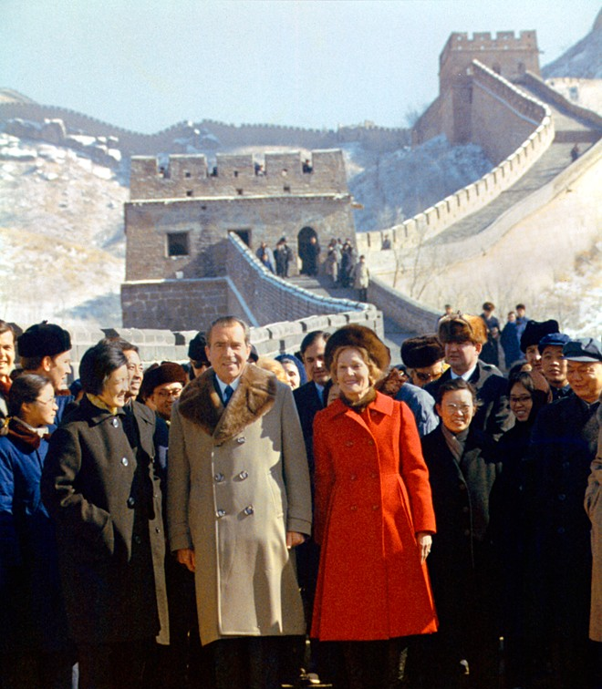
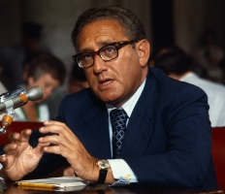
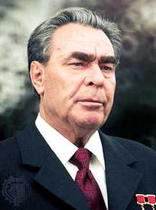
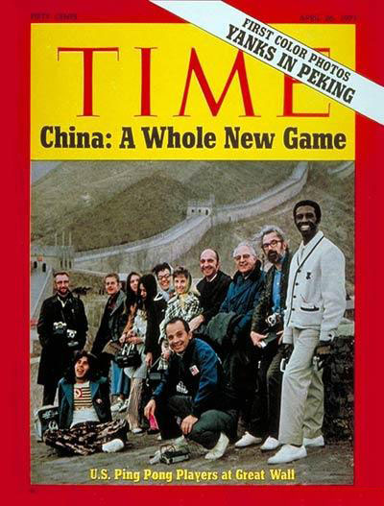
NIXON AND THE COLD WAR
Détente: A lessening of tensions between the US, China, and the USSR
Henry Kissinger
Improved relations for nearly a decade
SALT Treaty (Strategic Arms Limitation Treaty, 1969)
Signed by Nixon and Leonid Brezhnev
Notes:
Nixon was the first American to visit China in 25 years
“We want the Chinese with us when we sit down and negotiate with the Russians.”
April 1971 - Accidental meeting of Zhuang Zedong and Glenn Cowan
August 1971 - Journalists and table tennis players from the US become the first Americans to step foot in China since 1949
Strategic Arms Limitation Treaty (SALT, 1969) – a series of arms-reduction negotiations between the US and USSR
SALT I signed by Nixon and Brezhnev
Congress refused to sign the SALT II treaty after the Soviets invaded Afghanistan
Tensions arose as many countries began stockpiling nuclear weapons

Slide 11
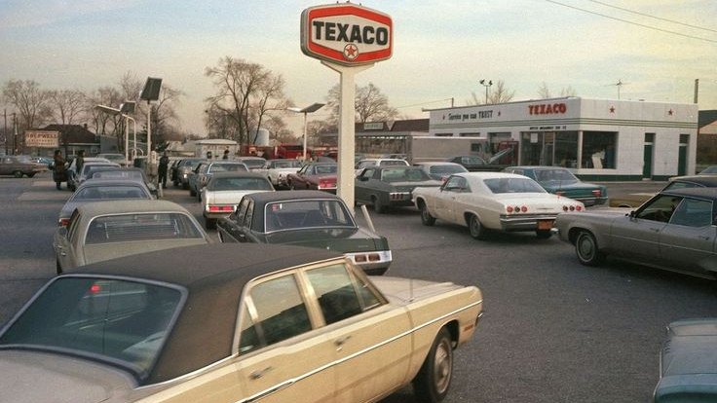
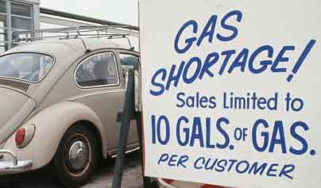
‘73 OIL EMBARGO
U.S. backs Israel in two wars against Arab Muslim countries and their Soviet allies
Organization of the Petroleum Exporting Countries (OPEC) Oil Embargo (1973)
Alaska Pipeline
Drive 55
Year-long Daylight Saving
Gas rotation
New focus on MPG
Notes:
Six-Day War and Yom Kippur War: Soviet-backed Syrians and Egyptians vs. U.S.-backed Israel
Organization of the Petroleum Exporting Countries (OPEC) places an embargo on the U.S.
Alaska Pipeline
Drive 55
Gas rotation
New focus on MPG (usu. Imports)

Slide 12
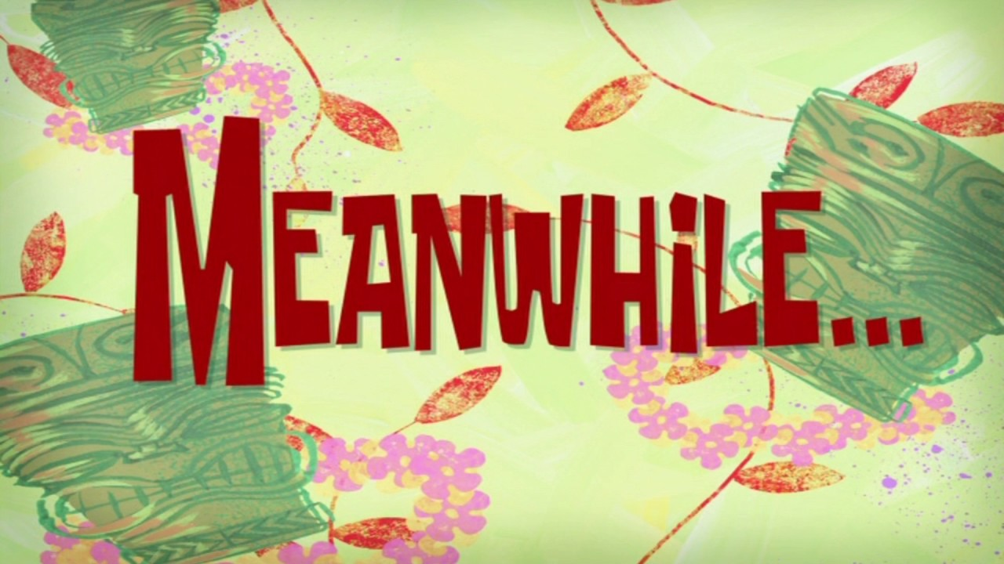

Slide 13
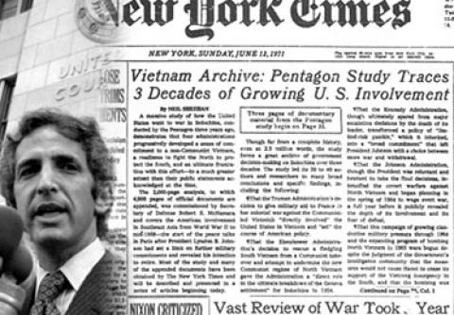
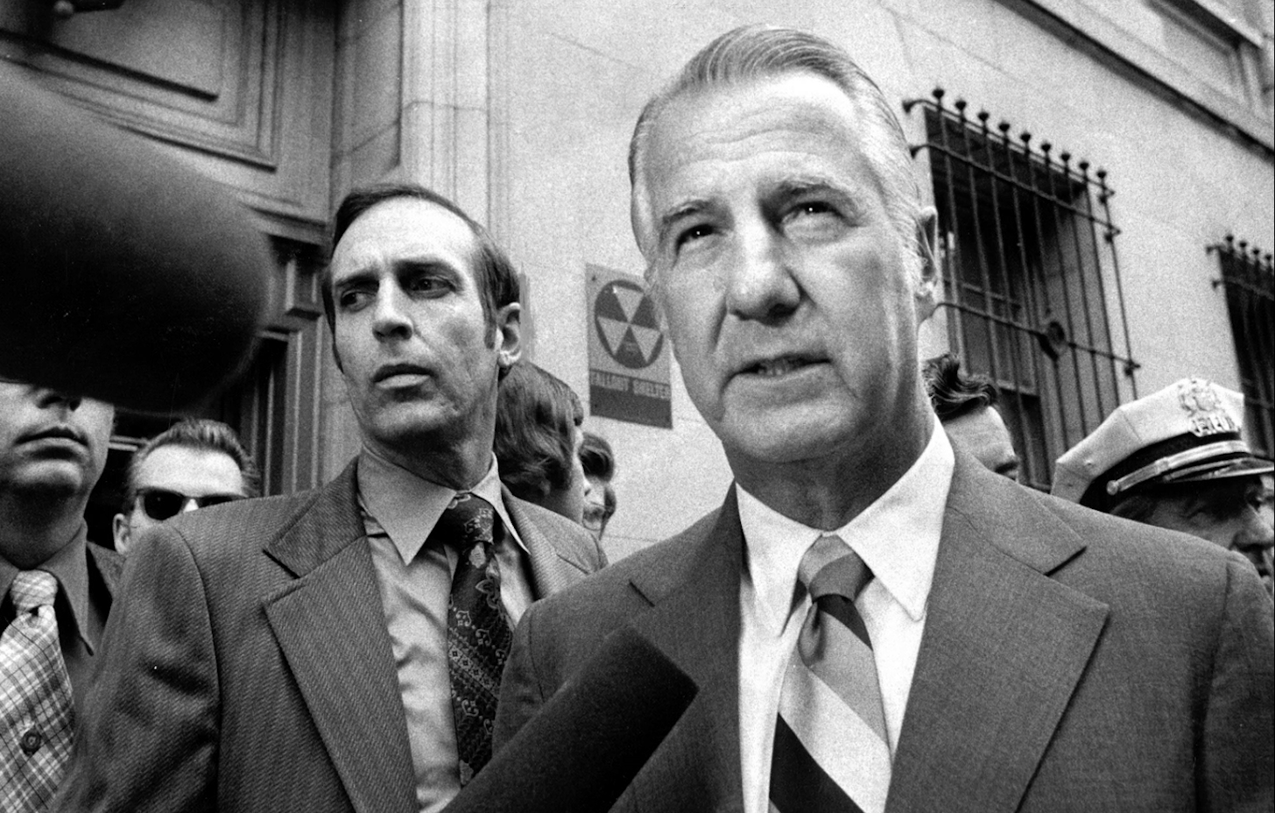
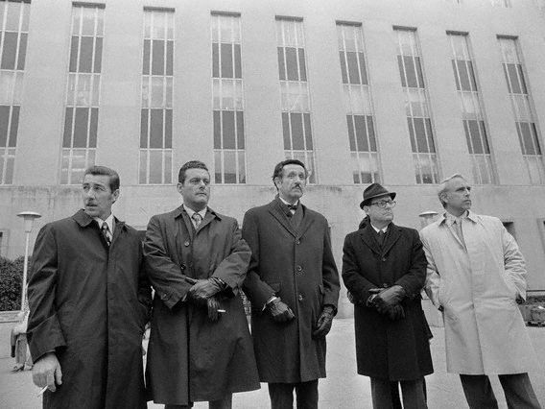
Nixon Needs a Plumber
1971 Pentagon Papers
VP Spiro Agnew resigns over corruption charges
Nixon hires ex-CIA agents to “plug the leaks”
Notes:
Agnew’s downfall began in the summer of 1973, when he was investigated in connection with accusations of extortion, bribery, and income-tax violations relating chiefly to his tenure as governor of Maryland. Faced with federal indictments, Agnew fought the charges, arguing that the allegations were false, that a sitting vice president could not be indicted, and that the only way he could be removed from office was by impeachment. After the solicitor general released a brief asserting that sitting vice presidents could be indicted, Agnew launched an attack on the administration and vowed not to resign. With Nixon in danger of impeachment for his role in the Watergate scandal, the administration sought to remove Agnew from the presidential line of succession, and secret plea bargaining took place between Agnew’s lawyers and a federal judge. Agnew resigned the vice presidency on October 10, 1973, and appeared in United States District Court in Baltimore on the same day to plead nolo contendere to a single federal count of failing to report on his income-tax return $29,500 in income that he had received in 1967, while governor of Maryland. Acknowledging that the plea amounted to a felony conviction, Agnew declared that he had resigned in the national interest. He was fined $10,000 and sentenced to three years of unsupervised probation.
August 21, 1971: Nixon's Enemies List is started by White House aides (though Nixon himself may not have been aware of it); to "use the available federal machinery to screw our political enemies.“ (e.g. break into the offices of Daniel Ellsberg's psychiatrist Lewis Fielding looking for material that might discredit Ellsberg)

Slide 14
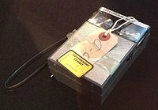
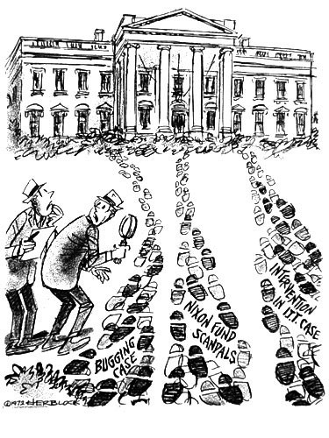
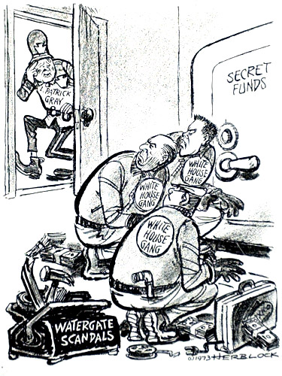
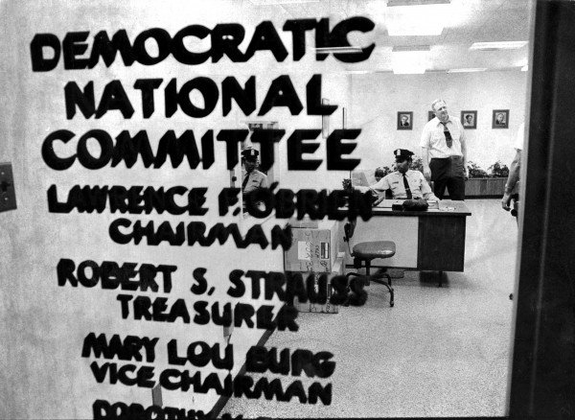
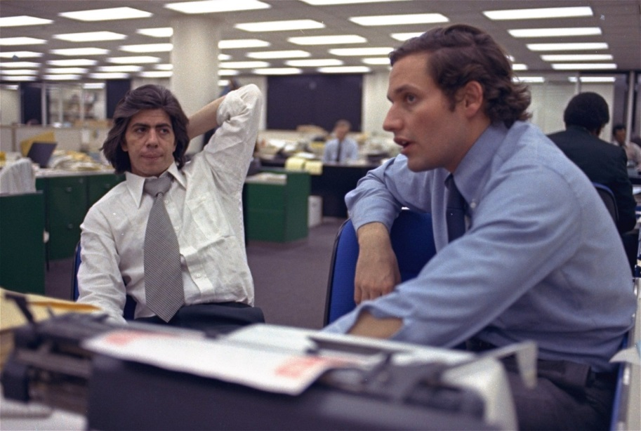
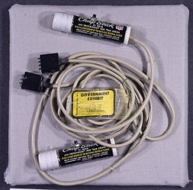
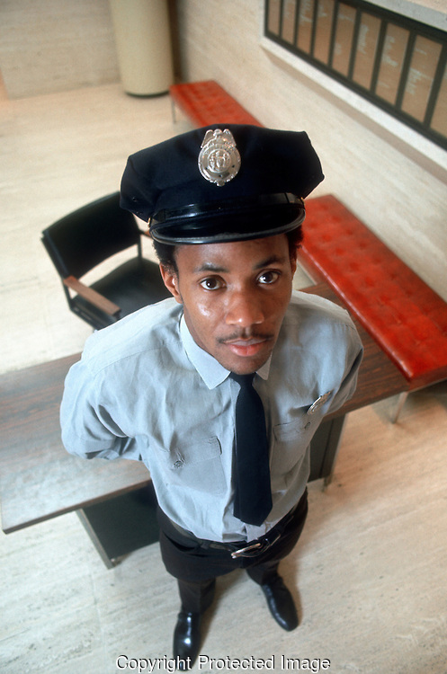
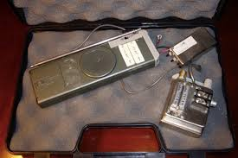
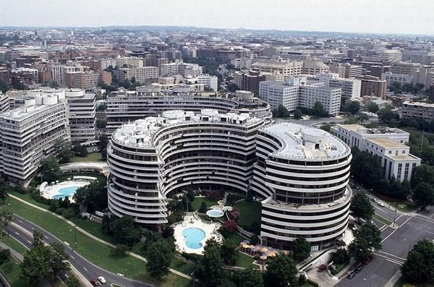
Watergate
Committee to Re-Elect the President (CREEP)
Break in at DNC Headquarters at Watergate Hotel
New FBI Director friendly to WH
Woodward and Bernstein reveal connection between WH and break-in in the Washington Post
“You must pursue this investigation of Watergate even if it leads to the president. I'm innocent. You've got to believe I'm innocent. If you don't, take my job.”
"Oops -- Sorry -- I Wouldn't Intrude On Highly Placed Gentlemen"
"Strange -- They All Seem to Have Some Connection With This Place"
Notes:
Pentagon Papers causes Americans to lose faith in the government (1971)
“Plumbers” created to stop WH “leaks”
Break in at DNC Headquarters at Watergate Hotel
Committee to Re-Elect the President (CREEP)
Bugged the DNC Headquarters
Two phones inside the offices of the DNC headquarters were said to have been wiretapped. Despite the success in installing the listening devices, the Committee agents soon determined that they needed to be repaired. They planned a second "burglary" in order to take care of this.
Shortly after midnight on June 17, 1972, Frank Wills, a security guard at the Watergate Complex, noticed tape covering the latches on some of the doors in the complex leading from the underground parking garage to several offices (allowing the doors to close but remain unlocked). He removed the tape, thinking nothing of it. But when he returned an hour later and discovered that someone had re-taped the locks, Wills called the police.
June 17, 1972 – Five “handymen” were arrested for the break-in
Bob Woodward and Carl Bernstein; Washington Post
J. Edgar Hoover dies, and Nixon places L. Patrick Gray as Director (friendly to Nixon), and instructs FBI to stop investigating the break-in
“Deep Throat” – FBI Agent Mark Felt leaks the connection between one of the “plumbers” and CREEP

Slide 15
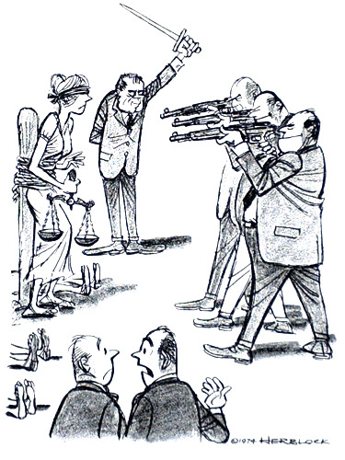
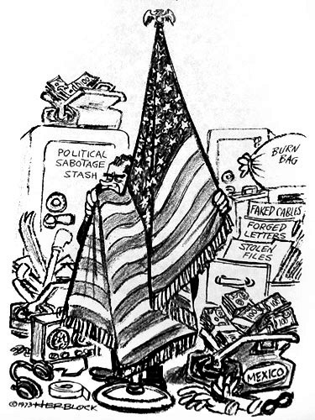
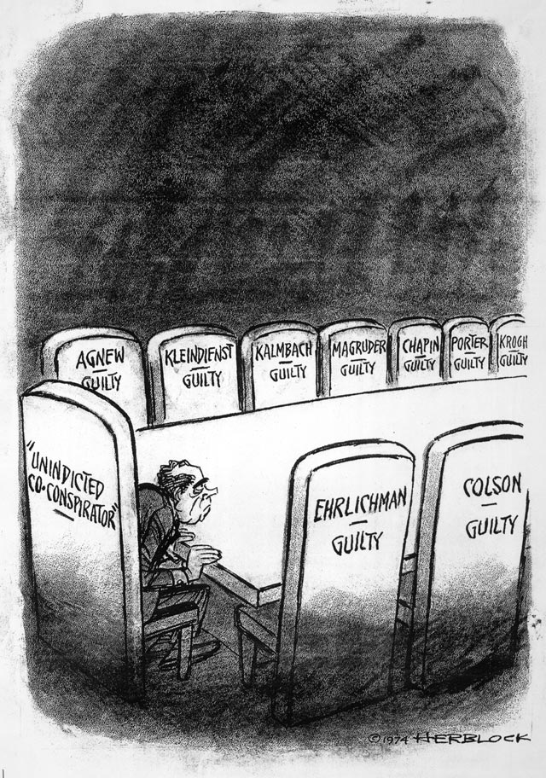
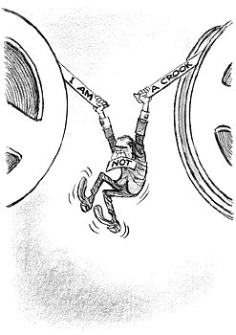
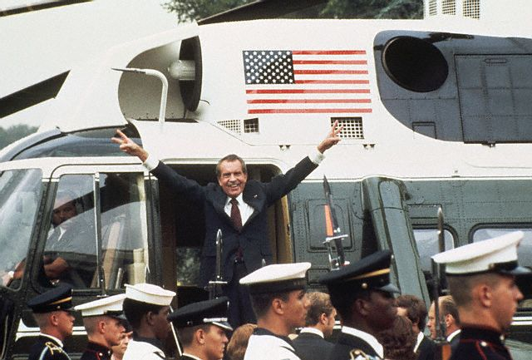
Watergate
High-ranking WH officials fired for their roles in the cover up
Oval Office recordings revealed and subpoenaed by Congress
Nixon refuses, citing executive privilege and national security
Saturday Night Massacre
“I am not a crook!”
United States v. Nixon
Suspicious 18-minute gap
Nixon resigns – August 9, 1974
Pardoned by Ford one month later
“How can they say he hasn’t faithfully executed the laws?”
Notes:
Four White House advisors lost their jobs for their role in the cover up
John Dean reveals that Nixon knew about the cover up
Alexander Butterfield reveals the existence of recordings of Oval Office conversations
Recordings subpoenaed by Congress, but Nixon refused, citing executive privilege and national security
Saturday Night Massacre: Nixon fires the AG, Deputy AG, and Special Prosecutor
“I am not a crook” speech
US v. Nixon: Nixon had to turn over the tapes, but had a suspicious 18-minute gap
One of the tapes revealed that Nixon was aware of the coverup since mid-1972
Nixon resigns rather than face impeachment – August 9, 1974
June 23, 1972: In the Oval Office, H.R. Haldeman recommends to President Nixon that they attempt to shut down the FBI investigation of the Watergate break-in, by having CIA Director Richard Helms and Deputy Director Vernon A. Walters tell acting FBI Director L. Patrick Gray to, "Stay the hell out of this". Haldeman expects Gray will then seek and take advice from Deputy FBI Director Mark Felt, and Felt will obey direction from the White House out of ambition. Nixon agrees and gives the order. [5] The conversation is recorded.
Implicated the president in a cover up of the break-in.
Refused to turn over the tapes, citing “presidential privilege” and “national security” - July 23, 1973: Nixon refuses to turn over presidential tapings to Senate Watergate Committee or the special prosecutor.
October 20, 1973: "Saturday Night Massacre" - Nixon orders Elliot Richardson and Ruckleshouse to fire special prosecutor Cox. They both refuse to comply and resign. Robert Bork considers resigning but carries out the order.
November 17, 1973: Nixon delivers "I am not a crook" speech at a televised press conference at Disney World (Florida).
U.S. v. Nixon: Nixon required to hand over the tapes; unauthorized taping not included under “presidential privilege”
Suspicious 18 minute blank spot on tapes
Nixon criticized by political cartoonist Herb Block (“Herblock”)
By July 14, 1974, President Richard Nixon stood almost alone. His vice-president Spiro Agnew, pleaded nolo contendere to a charge of tax evasion, and was forced to resign. Many of Nixon's closest aides had been convicted of illegal activities. Nixon himself was named an "un-indicted co-conspirator" by the Watergate grand jury. A few days later, the House Judiciary Committee recommended impeachment, and the Supreme Court required him to turn over all subpoenaed tapes. When even his closest friends, reviewing these tapes, agreed that the evidence against him was overwhelming, Nixon bowed to the inevitable, resigning on August 9
Three articles of impeachment were recommended by House Judiciary Committee
Congress moves to impeach Nixon.July 27 to July 30, 1974: House Judiciary Committee passes articles of Impeachment.
Early August 1974: A previously unknown tape from June 23, 1972 (recorded a few days after the break-in) documenting Nixon and Haldeman formulating a plan to block investigations, is released. This recording would later become known as the "Smoking Gun".
Key Republican Senators tell Nixon that enough votes exist to convict him.
Led to Nixon’s resignation in 1974
“Deep Throat” revealed in 2005
Pardoned by Gerald Ford
1. Obstruction of justice through ‘hush money’ and withholding evidence
2. Using Federal agencies to deprive citizens of their constitutional rights
3. Defiance of Congress. (for withholding the tapes)

Slide 16
Ford’s Administration

Slide 17
Ford’s Administration
Struggles against stagflation
American bicentennial
Two assassination attempts
First President to be satirized on SNL ☺
Notes:
Assassination attempts:
Lynette "Squeaky" Fromme, a follower of Charles Manson, pointed a Colt 45-caliber handgun at Ford. She wanted to make a statement to people who refused to halt environmental pollution and its effects
As Fromme pulled the trigger, a Secret Service agent, grabbed the gun and managed to insert the webbing of his thumb under the hammer, preventing the gun from firing.
17 days after 1st attempt; Sara Jane Moore, standing in a crowd of onlookers across the street, pointed her pistol at him.
Just before she fired, former Marine grabbed at the gun and deflected her shot

Slide 18
Election of 1976
Election of 1976: Ford (R) vs. Carter (D)
“Jimmy” Carter
Ran as the Washington outsider
Devout Christian – aimed to bring morality back to politics
Notes:
"Don’t vote—it only encourages them” is a joke that television comedian Jack Paar told in May 1966. During the presidential election year of 1976, the saying was put on buttons and bumper stickers.

Slide 19
The Carter Years

Slide 20
Peanuts, Not Politics
Struggles to work with Congress
Dept. of Energy
Tax cuts to fight inflation
Pardons Vietnam draft dodgers
Deregulation of transportation
Crisis of Confidence

Slide 21
MELTDOWN!
Partial meltdown at Three Mile Island nuclear plant in PA (1979)
Worst in U.S. history
Carter reacted quickly; created an investigative committee to prevent another accident
Prompted protests and demands for clean energy
Notes:
It was the worst accident in U.S. commercial nuclear power plant history, but Carter reacted swiftly and effectively to ensure the safety of citizens, as well as create an investigative committee to prevent another accident.

Slide 22
Foreign Affairs
Camp David Accords – Carter invited the leaders of Egypt and Israel to a conference at Camp David, in which he persuaded them to sign a peace accord.
Panama Canal Treaty – Vowed to give full control of the Panama Canal over by the year 2000.
Soviet invasion of Afghanistan ⇨ Boycott of 1980 Moscow Olympics ⇨ Boycott of 1984 LA Olympics
President Anwar Sadat of Egypt (left) and Prime Minister Menachem Begin of Israel (right)
Notes:
Israel would withdraw from disputed territory
Egypt would respect Israel’s borders

Slide 23
Iran Hostage Crisis
52 Americans held hostage for 444 days after Islamic militants took over the American Embassy in Tehran
Supported by Ayatollah Ruhollah Khomeini
Failed negotiations and rescue missions
Hostages released minutes after Ronald Reagan is sworn into office
Notes:
America deposes democratically elected nationalist premier, Mohammed Mossadegh after he seized British oil properties (1953)
Place Mohammed Reza Pahlavi as shah
American-supported Shah deposed
Carter allows him to get medical attention in the U.S.
Riots in Iran, demanding he be brought to justice
52 Americans held hostage for 444 days after a group of Islamist students and militants took over the American Embassy in Tehran.
Ayatollah Ruhollah Khomeini
Failed release negotiations and rescue missions
Enter into negotiations after Shah dies and Iraq invades
Hostages released minutes after Ronald Reagan is sworn into office.

Slide 24
The “Me” Generation

Slide 25
The “Me” Generation
Boomer” generation that came of age in the 1970s
Indulgent and self-involved
Causes: Economic prosperity, disillusionment in traditional authority, lack of social movements, and deaths of unifying social leaders
“Self-realization" and "self-fulfillment"
Divorce rates soar; birthrates drop
Notes:
Refers to the “boomer” generation that came of age in the 1970s that was self-indulgent and self-involved
Caused by economic prosperity, disillusionment in traditional authority, lack of social movements (e.g. civil rights), and deaths of unifying social leaders (e.g. MLK, JFK, RFK)
“Self-realization" and "self-fulfillment"
Divorce rates soar; birthrates drop

Slide 26
The “Me” Generation
Rapid technological advancement (e.g. first personal computer, first “test tube” baby)
Rise of “New Age” spirituality and cults (e.g. Patty Hearst kidnapping, Jonestown Suicides)
Focus on health and fitness (jogging, aerobics, weightlifting)
Emphasis on entertainment
TV and Movies: More racial and gender diversity; tackled controversial social issues
Music: No longer used to get across a message, simply meant to enjoy (rap and punk exceptions)
Fun and Fads: Enjoy yourself, don’t think too hard!

