Slide 1
Social Upheaval in the Cold War

Slide 2
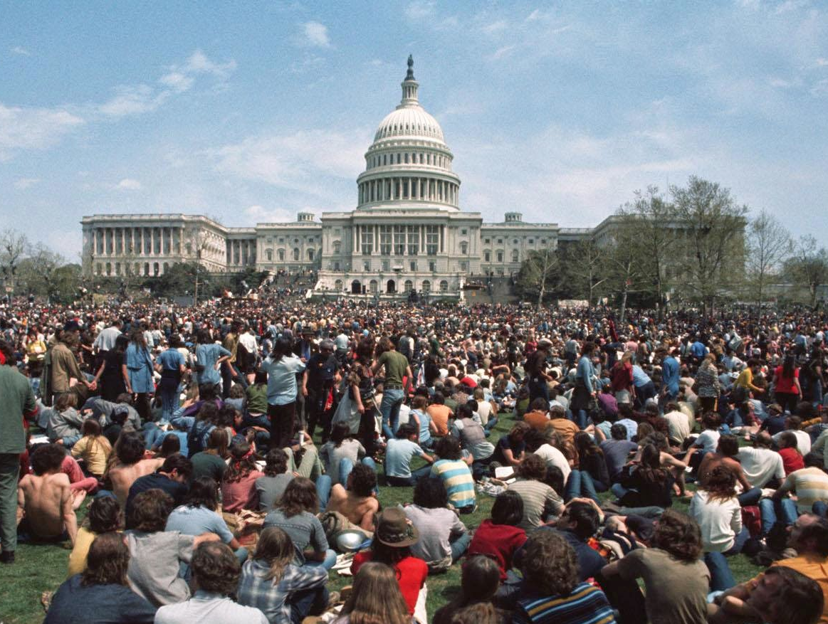
Political Upheaval

Slide 3
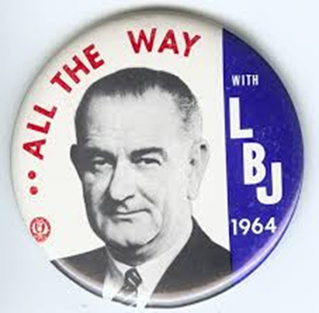
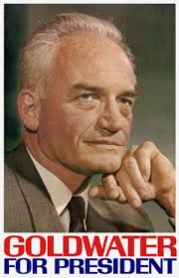
Political Conflict
Election of 1964
LBJ (D) vs. Barry Goldwater (R)
The Conscience of A Conservative
Supported by Ronald Reagan
Neo-Conservatism/The New Right: Anti-Civil Rights Movement + religious conservatism
The New Left: Sought greater social, political, and economic equality
Notes:
Goldwater the first true conservative since WWII
Post WWII: 1950s Conservatism ⇨ 1960s/70s: Rebellion ⇨ 1980s: Conservatism
Goldwater:
First conservative to be nominated since WWII
A Time For Choosing: attacked the New Deal state; the problem with the Republican Party, as he saw it, was that Eisenhower had been too accommodating to liberalism; later attacked “containment” for being too timid in the face of communism
“A Time for Choosing”: Reagan warned that if we “trade our freedom for the soup kitchen of the welfare state,” the nation would “take the first step into a thousand years of darkness.”

Slide 4
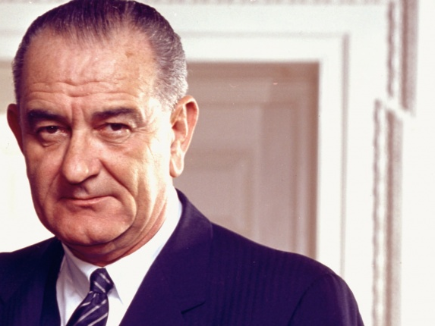
Johnson’s “Great Society”
A set of economic and social welfare measures pushed through by LBJ
Medicare/Medicaid, Food stamps, Public radio/TV, federal funding for education, Immigration Act of 1965
Notes:
Information is behind the picture.
Medicare and Medicaid provided medical care to those who needed it most. Medicare = Old people who need CARE; Medicaid = Injured and poor people who need AID
Immigration and Nationality Services Act – Got rid of the 1924 quotas that had limited immigration
Extension of constitutional protections to Native Americans on reservations
Job Corps – provided training and jobs for America’s youth
Federal Food Stamp Program – providing assistance to low-income families to provide food
Head Start and federal funding for public universities
National Endowment for the Arts, Public Broadcasting Act (PBS) and National Public Radio (NPR), Kennedy Center for the Arts
Endangered Species Preservation Act, Clean Air Act

Slide 5
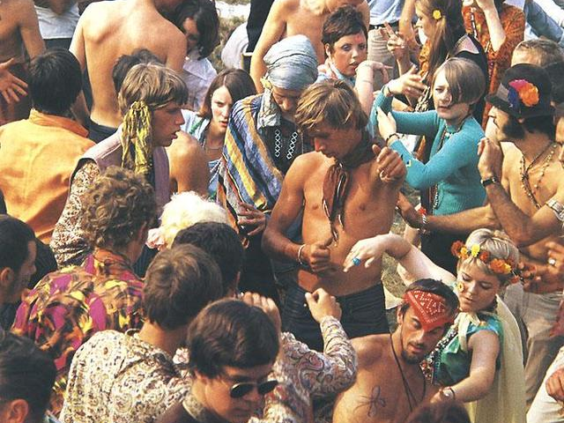
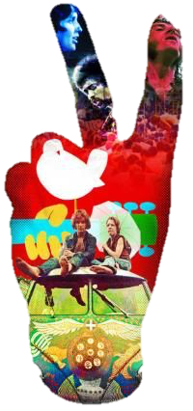
Tune in, turn on, and check out!
The Counterculture

Slide 6
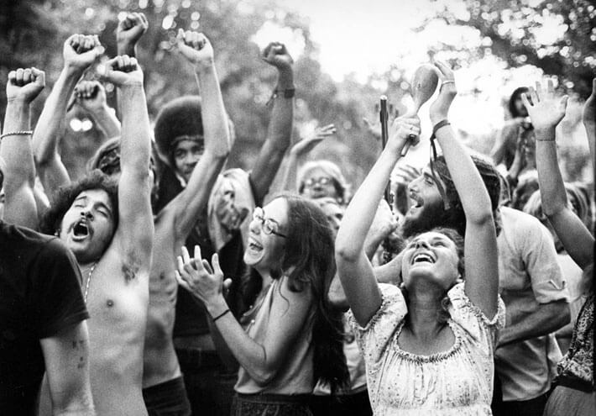
The Counterculture
Counterculture: A reactionary, anti-conformist group that arose in the mid 1960s
Held liberal views on race, gender, and sexuality, denounced the Vietnam War, experimented with drugs, and questioned conformity, traditional authority, and the American Dream
Reaction to the conservatism and conformity of the 1950s; inspired by the Beat Generation
Most were white, young, and from conservative middle-class families.

Slide 7
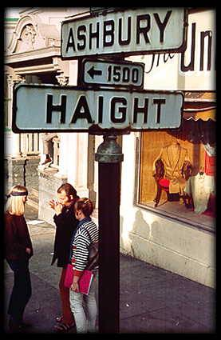
Hippies
Congregated in SF; Haight-Ashbury neighborhood
Believed in a utopian ideal, experimented with psychedelic drugs, lived communally, adopted the policy of “free love”, communal living, and developed a vibrant music scene
“Summer of Love” (1967)
Notes:
Hippies first introduced at the Human Be-In in 1967 at Golden Gate Park, SF.
Believed in a utopian ideal: a society that was freer, closer to nature, full of love, empathy, tolerance, and cooperation.
San Francisco (Be Sure to Wear Flowers in Your Hair): Was written and released in 1967 to promote the Monterey Pop Festival

Slide 8
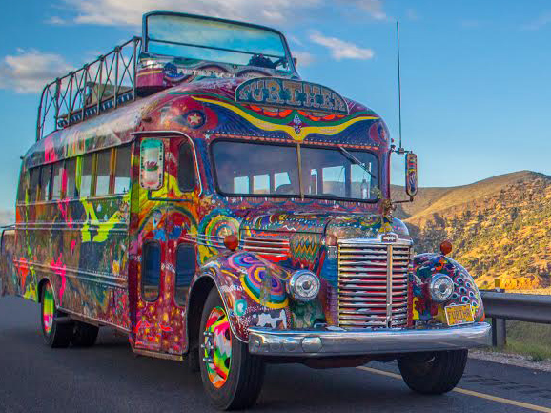
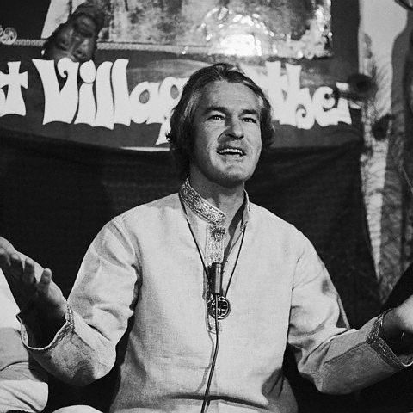
Drug Culture
Use of hallucinogenic drugs (marijuana, LSD, “Magic Mushrooms,” and mescaline)
Dr. Timothy Leary
Ken Kesey and the Merry Pranksters
Turn On, Tune In, Drop Out
Notes:
Hippies used hallucinogenic drugs to raise consciousness and “expand their minds”
LSD first developed by the federal government as a potential mind control weapon in the Cold War
Dr. Timothy Leary: Proponent of LSD; conducted experiments using LSD in psychotherapy at Harvard University.
“Tune in, turn on, drop out” as a motto for the hippie culture.
Dr. Timothy Leary was an early advocate of LSD experimentation. He taught psychology at Harvard university, and by 1960 was experimenting with LSD and other hallucinogens. He coined the phrase "Turn On, Tune In, and Drop Out," and formed the "League of Spiritual Discovery," an LSD advocacy group. In the mid sixties, he began attending numerous musical events and public forums that promoted the use of LSD.
Many members of the counterculture embraced spirituality and alternative religions
Astrology
Eastern religions
New forms of Christianity
Religious groups centered around authoritarian leaders
Parental figure and extended families
Cult-like
Unification Church:
Founded by Rev. Sun Myung Moon
Members called “Moonies”
Consider Moon to be the new Messiah and seek to create Heaven on Earth through world peace
The Hare Krishna movement:
Branch of Hinduism; worship the god Krishna
Repeat the mantra Hare Krishna
First converts were hippies in New York City
Shaved their heads and adopted Indian clothing as signs of membership.
Chant and dance in public (a practice called kirtan) and sold religious texts in airports.

Slide 9
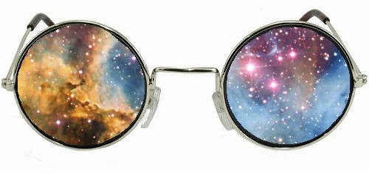
Virtual ACID Trip
Notes:
Click on the glasses for an optical illusion video

Slide 10
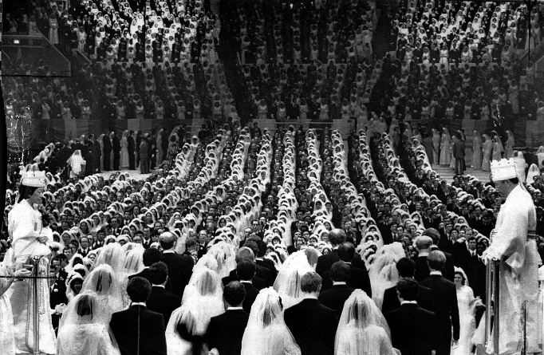
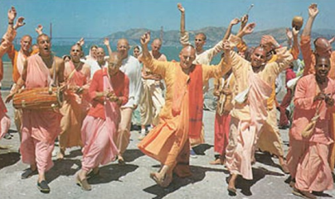
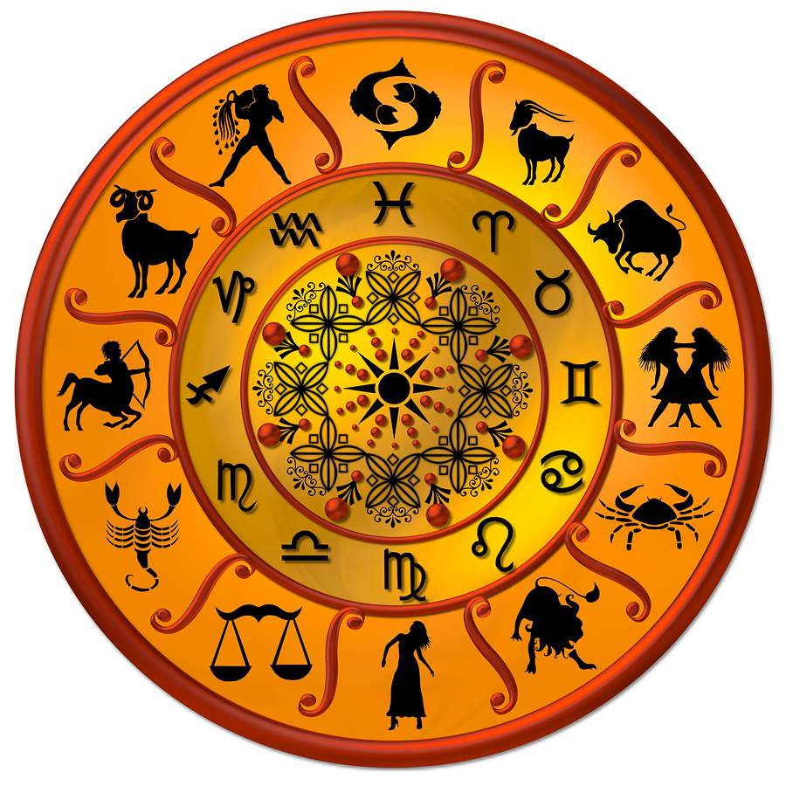
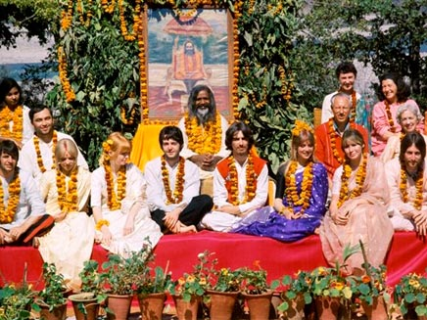
Religion
Many members of the counterculture embraced spirituality and alternative religions
Astrology, Eastern religions, New forms of Christianity
Notes:
Unification Church:
Founded by Rev. Sun Myung Moon
Members called “Moonies”
Consider Moon to be the new Messiah and seek to create Heaven on Earth through world peace
The Hare Krishna movement:
Branch of Hinduism; worship the god Krishna
Repeat the mantra “Hare Krishna”
First converts were hippies in New York City
Shaved their heads and adopted Indian clothing as signs of membership.
Chant and dance in public (a practice called kirtan) and sold religious texts in airports.

Slide 11
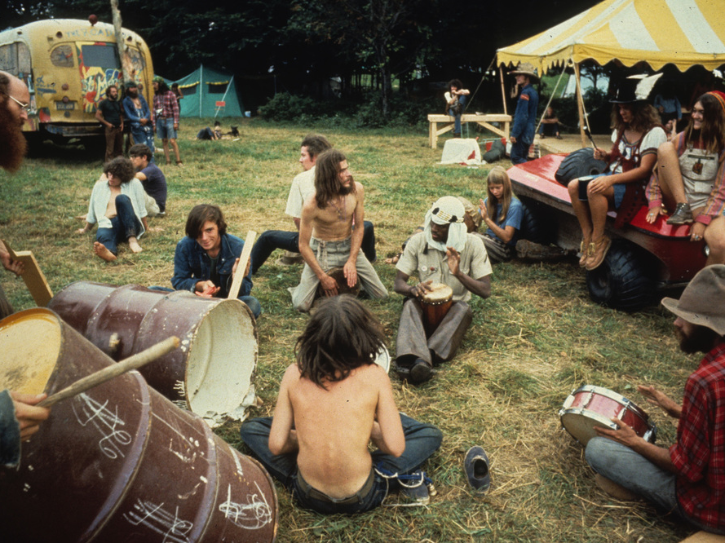
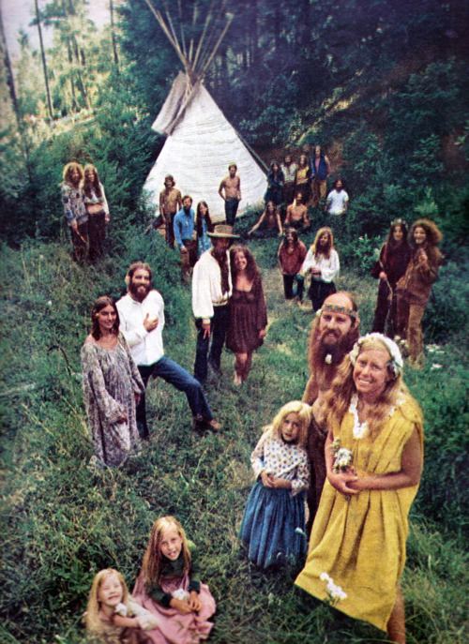
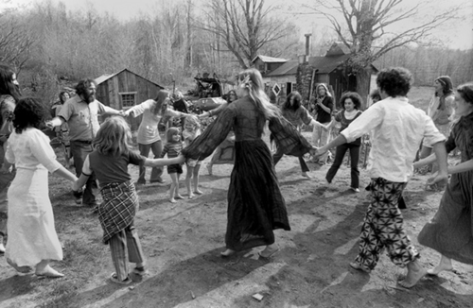
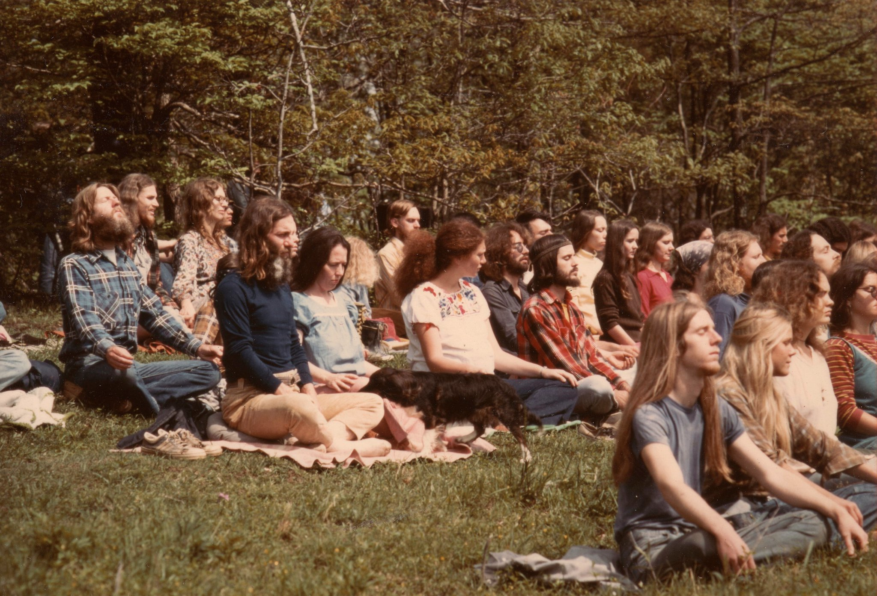
Communes

Slide 12
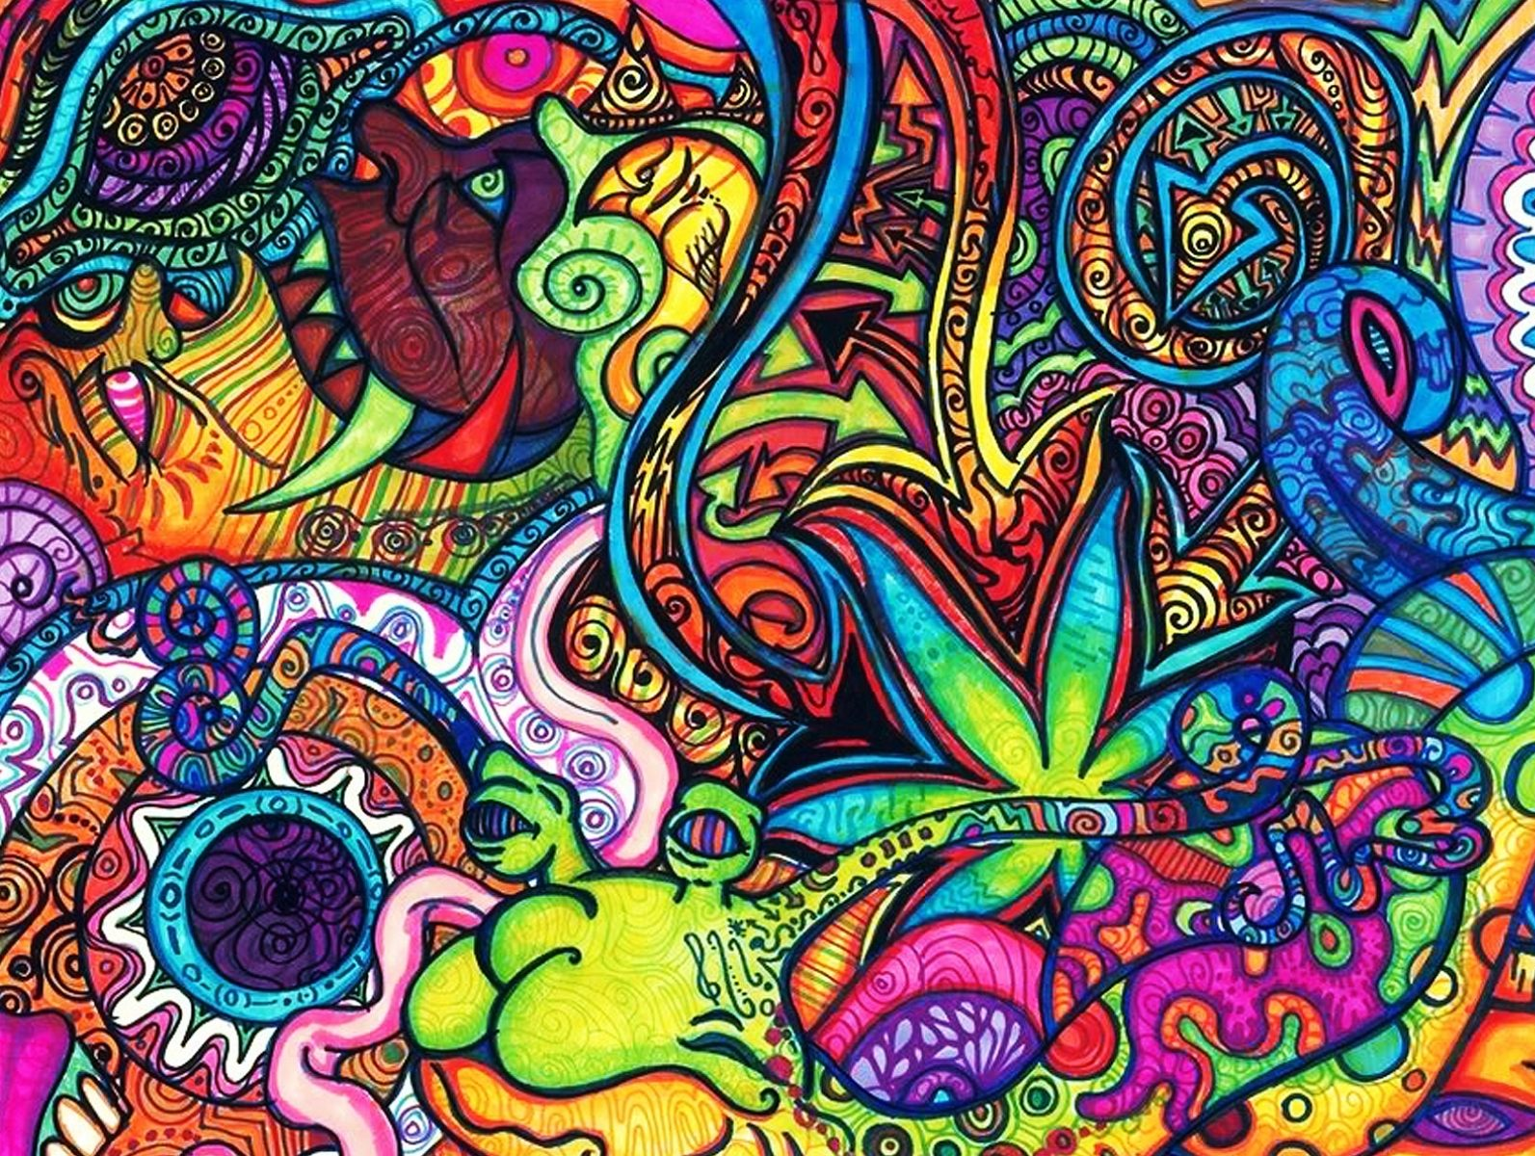
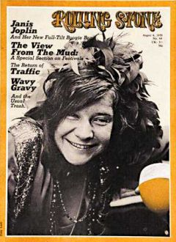
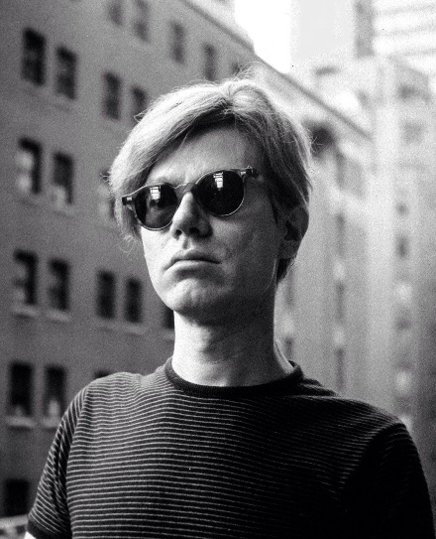
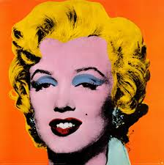
Media, and Art
Produced art and literature that reflected counterculture ideals
Rolling Stone magazine
Pop Art (Andy Warhol), Avant-garde
Notes:
Underground newspapers and magazines; e.g. Rolling Stone
Counterculture art was highly influenced by Dada
Avant-garde and Anti-Art genres.
Andy Warhol and Pop Art
Folk Music revival: Highly involved in the civil rights and free speech movements
Bob Dylan, Joan Baez, and Peter, Paul & Mary
The British Invasion: Influenced by the folk music scene and early rock and roll
The Rolling Stones, The Animals, The Who, Herman’s Hermits, Manfred Mann
The Beatles came to the United States on February 7, 1964 to perform on the Ed Sullivan Show. The screams of the audience made much of their performance unable to be heard.

Slide 13
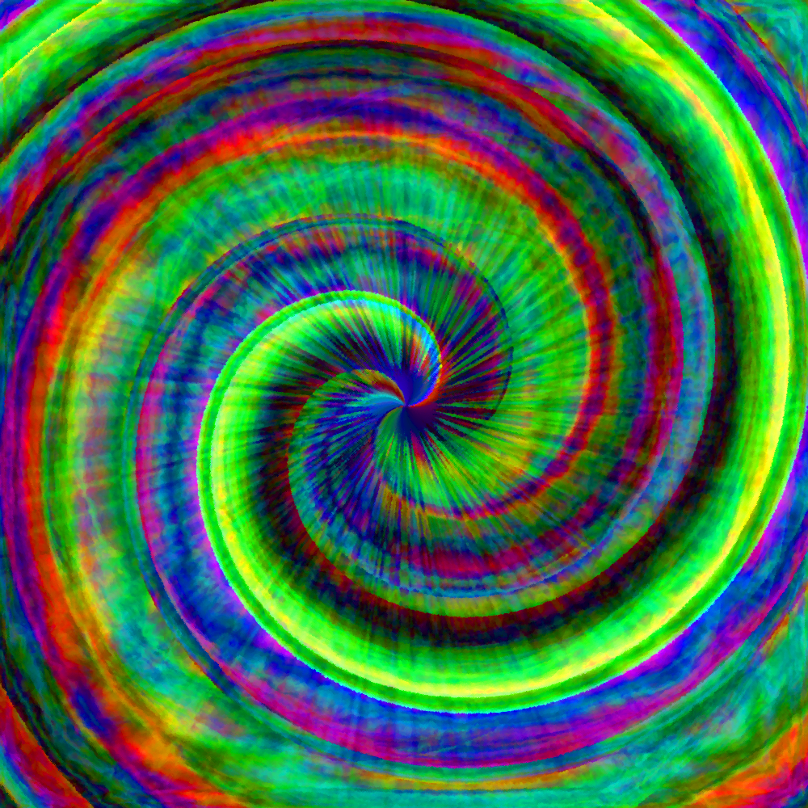
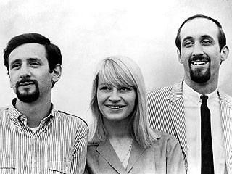
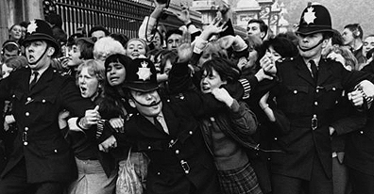
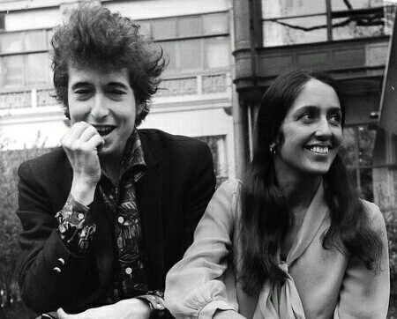
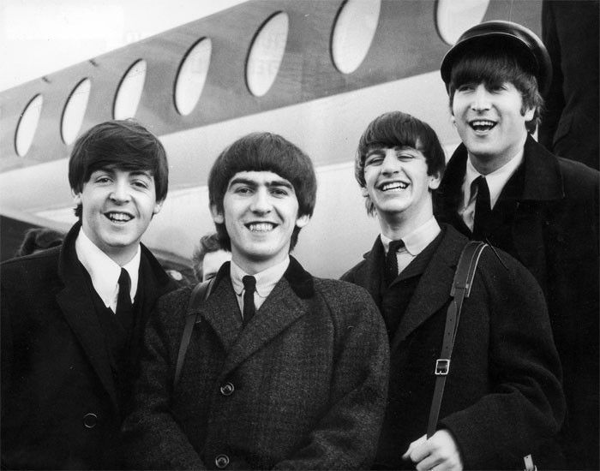
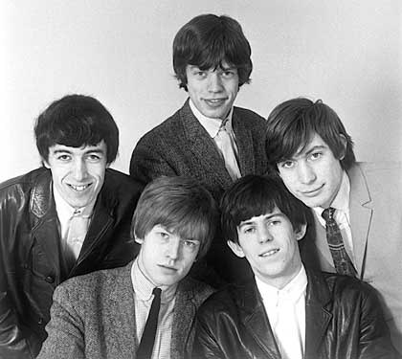
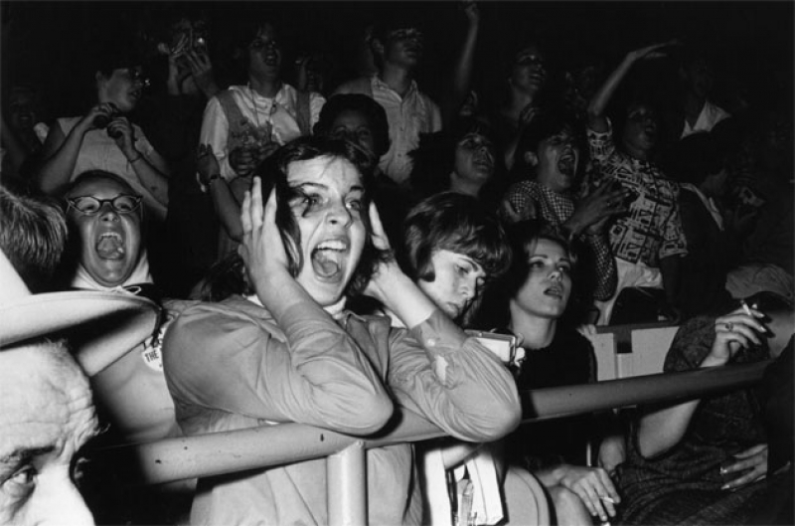
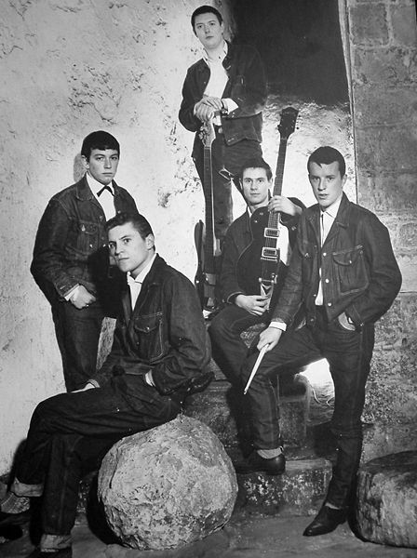
MUSIC
Folk Music revival (1950s-1960s) – protest and civil rights
The British Invasion – Classic American rock ’n’ roll with grit
Beatlemania!
Notes:
Folk music: Bob Dylan, Joan Baez, and Peter, Paul & Mary
British Invasion: The Rolling Stones, The Animals, The Who, Herman’s Hermits, Manfred Mann

Slide 14
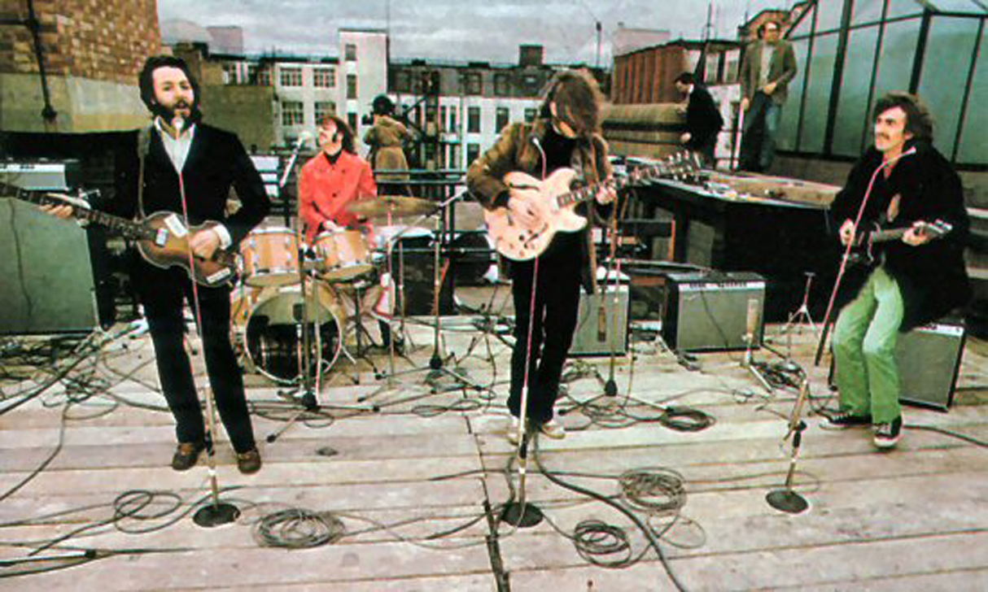
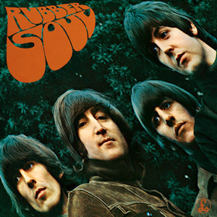
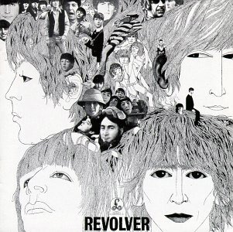
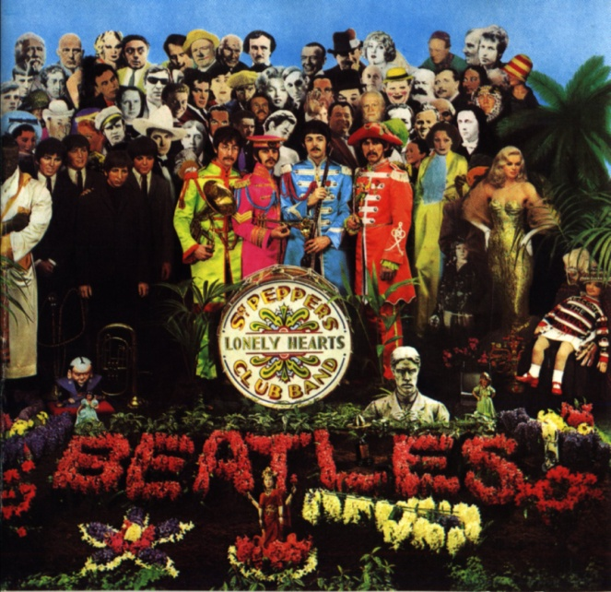
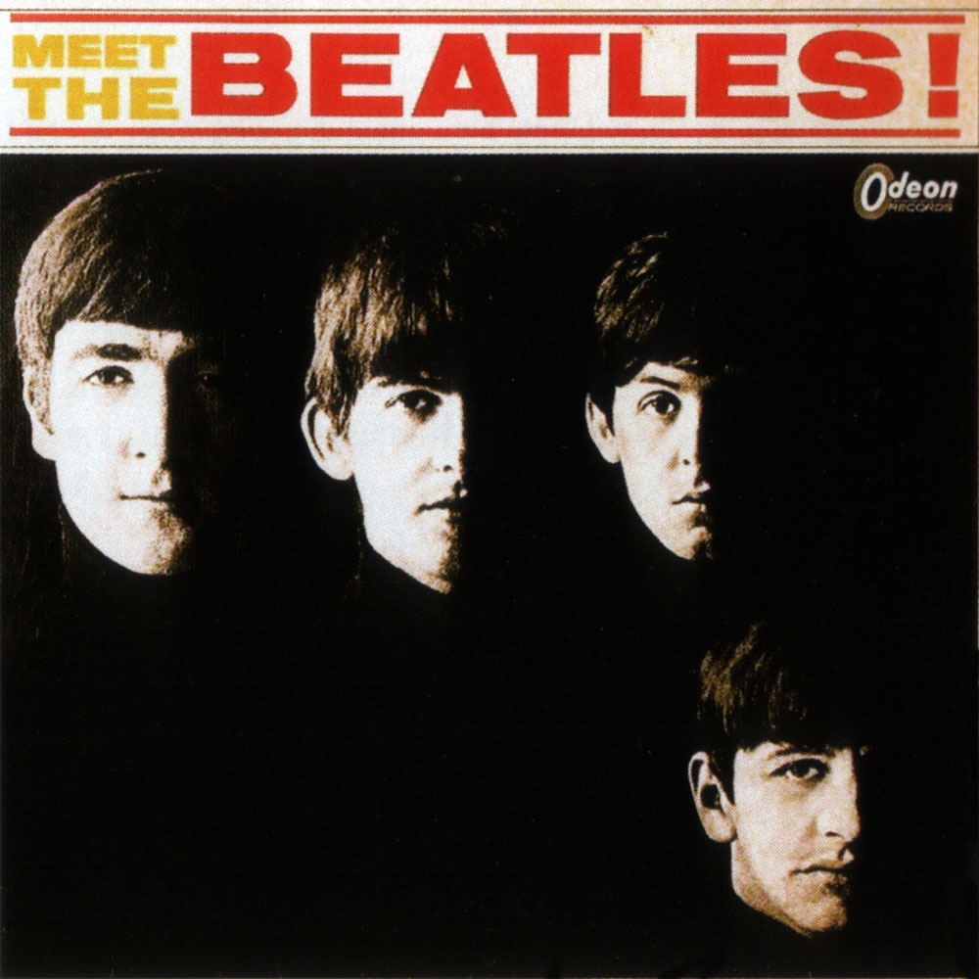
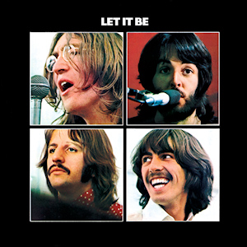
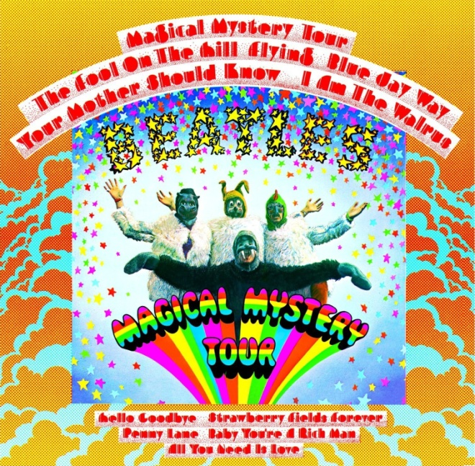
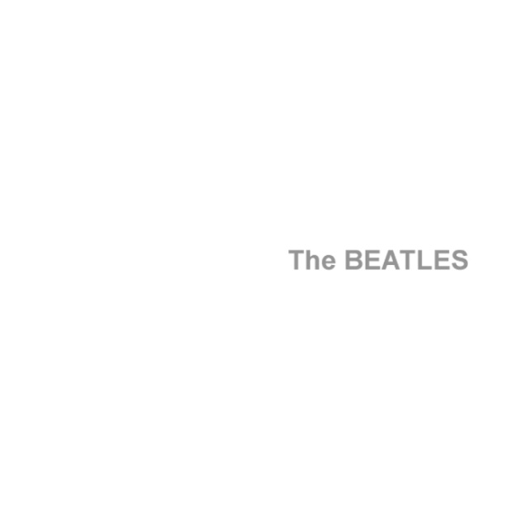
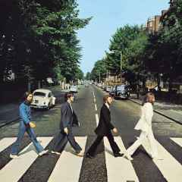
The Fab Four Evolves
Notes:
Meet the Beatles (1964)
Rubber Soul (1965)
Revolver (1966)
Sgt. Pepper (1967)
Magical Mystery Tour (1967)
The White Album (1968) – Back in the USSR, Dear Prudence, Oh-Bla-Di Oh-Bla-Da, Happiness is a Warm Gun, While My Guitar Gently Weeps, Blackbird, Helter Skelter, Revolution
Abbey Road (1969)

Slide 15
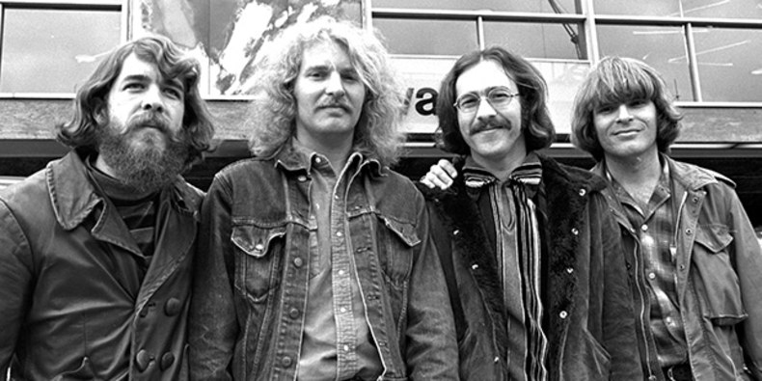
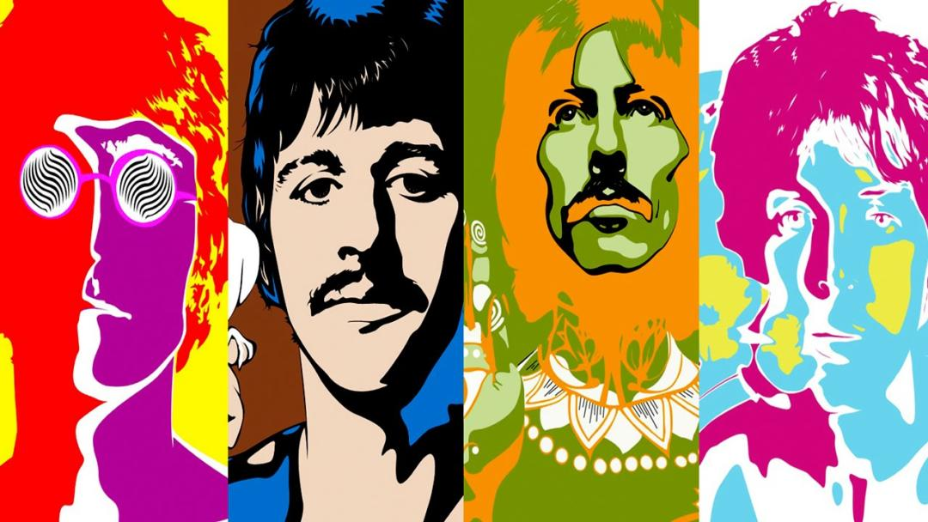
MUSIC
Music became increasingly experimental and heavily involved in antiwar movement
Psychedelic Rock: Written and meant to be experienced while under the influence of psychedelic drugs.
Notes:
Folk music: Bob Dylan, Joan Baez, and Peter, Paul & Mary
British Invasion: The Rolling Stones, The Animals, The Who, Herman’s Hermits, Manfred Mann

Slide 16
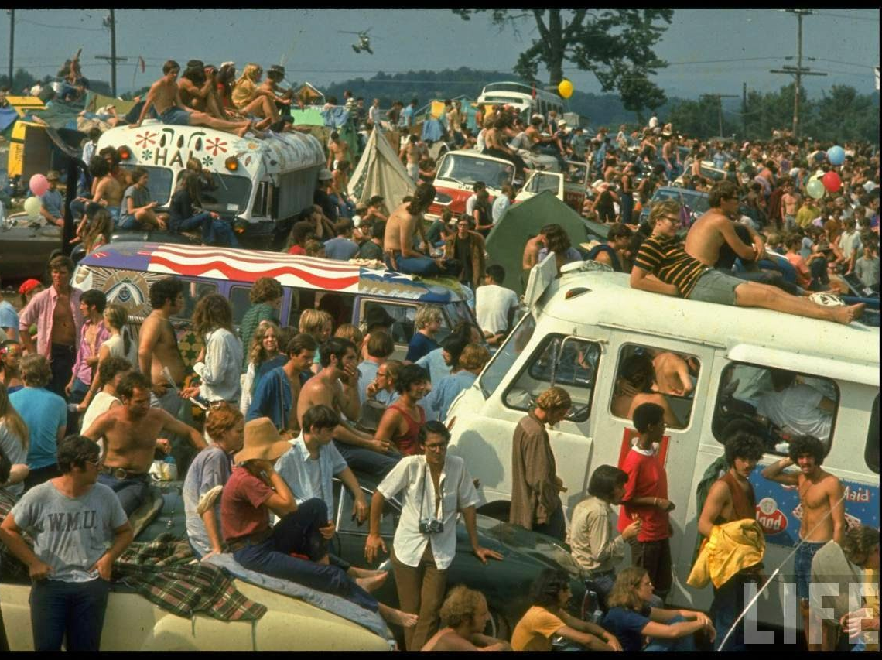
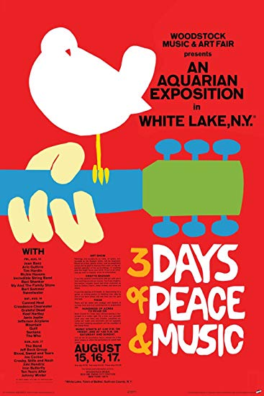
Welcome to Woodstock!

Slide 17
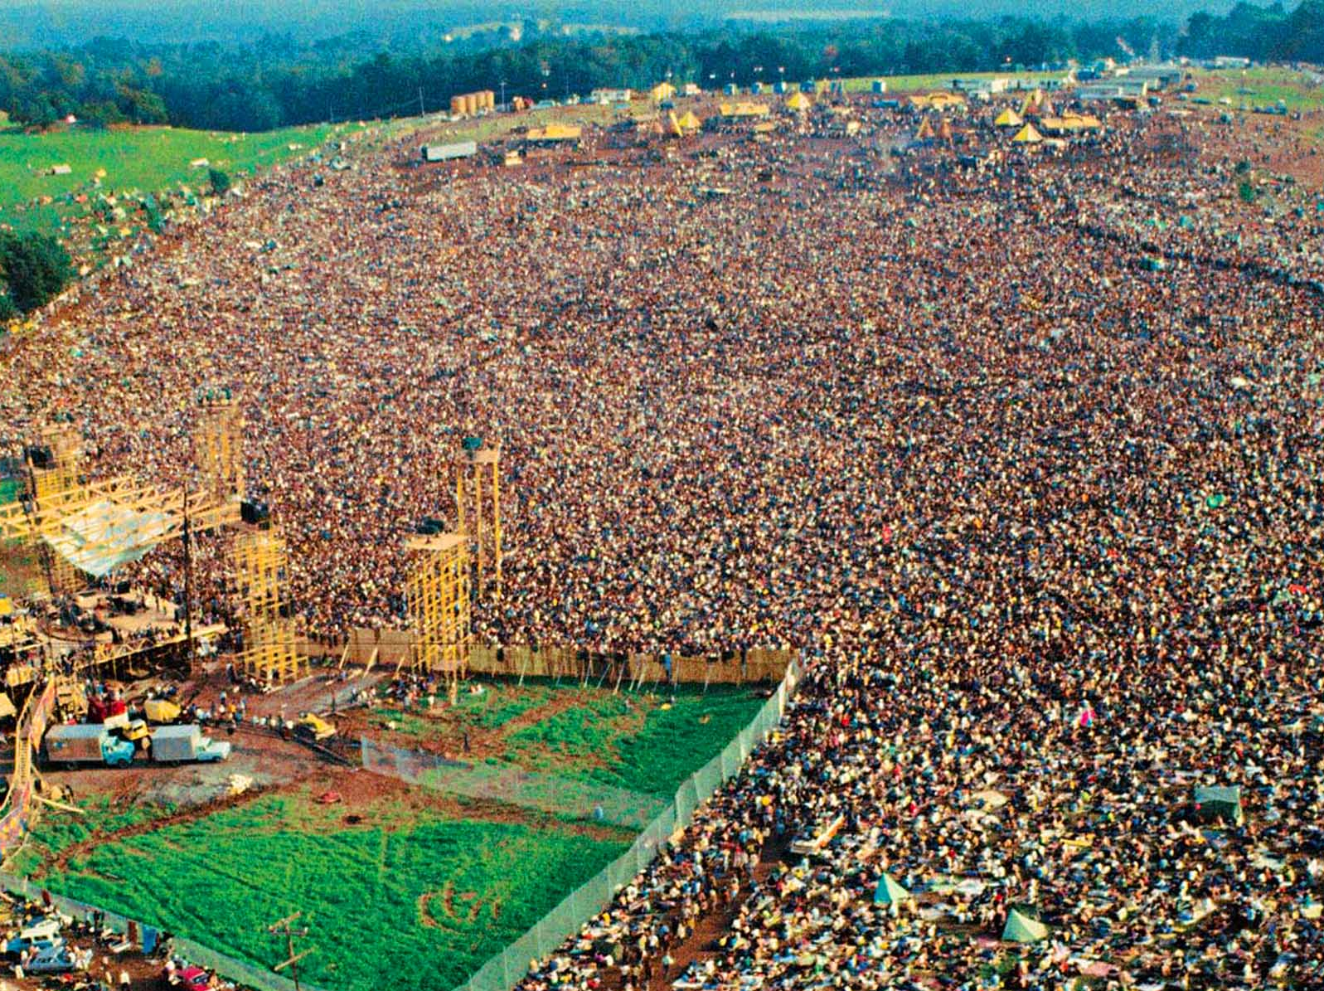
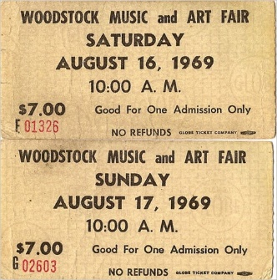
Woodstock
Three-day music and art festival in NY
32 of the best known musicians played in front of over a half a million people.
The behaviors exemplified the counterculture movement
Notes:
Two days before the festival was supposed to start, 50,000 people had already arrived before all the fencing was built
Fencing was planned to go up the day before it started, but it was never completed
The promoters thought of collecting tickets but realized they never could because of the amount of people who already there could have started a riot
Word got around that they wouldn’t be collecting tickets which prompted more people to attend
Jefferson Airplane, Joan Baez, Santana, Janis Joplin, The Grateful Dead, CCR, Sly & the Family Stone, The Who, Blood Sweat and Tears, Country Joe and the Fish, Crosby Stills Nash & Young…

Slide 18
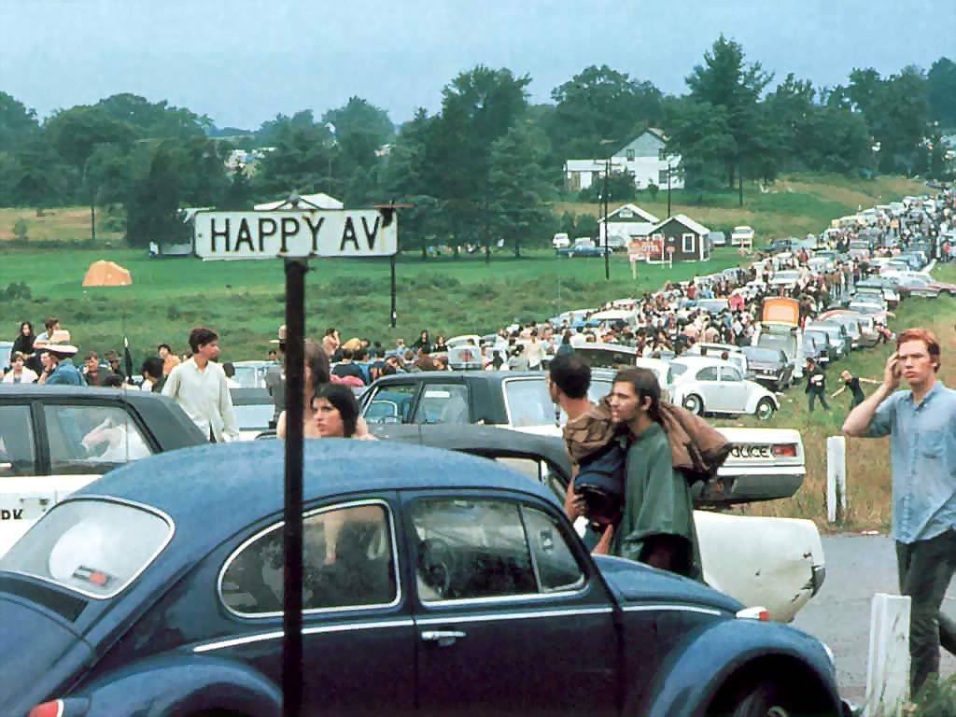
3 Days of Peace and Music….
1st Day
50,000 people had already arrived two days before all the fencing was built
Word got around that they wouldn’t be collecting tickets which prompted more people to attend
Traffic backed up for miles, so concertgoers ditched their cars and hiked in to the show. Some performers missed their sets.
Notes:
The promoters thought of collecting tickets but realized they never could because of the amount of people who already there could have started a riot
The morning of the festival an exodus of people arrived
The road leading in was traffic jammed, people decided to leave their cars and walk to the festival site
500,000 people were able had arrived, 1 million others tried to get in
Became the third largest city in NY during the weekend
Sweetwater, a psychedelic rock band was scheduled to open the festival, but they were stuck in traffic. Instead, the crowd was entertained by one of the Hog Farmers, who led them through a series of yoga exercises.

Slide 19
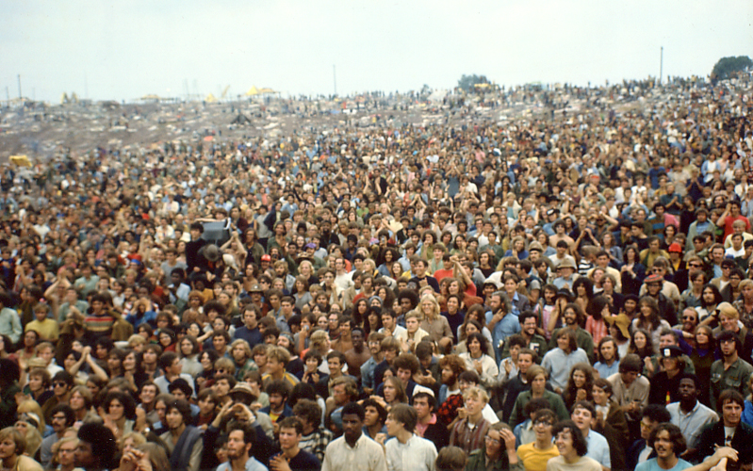
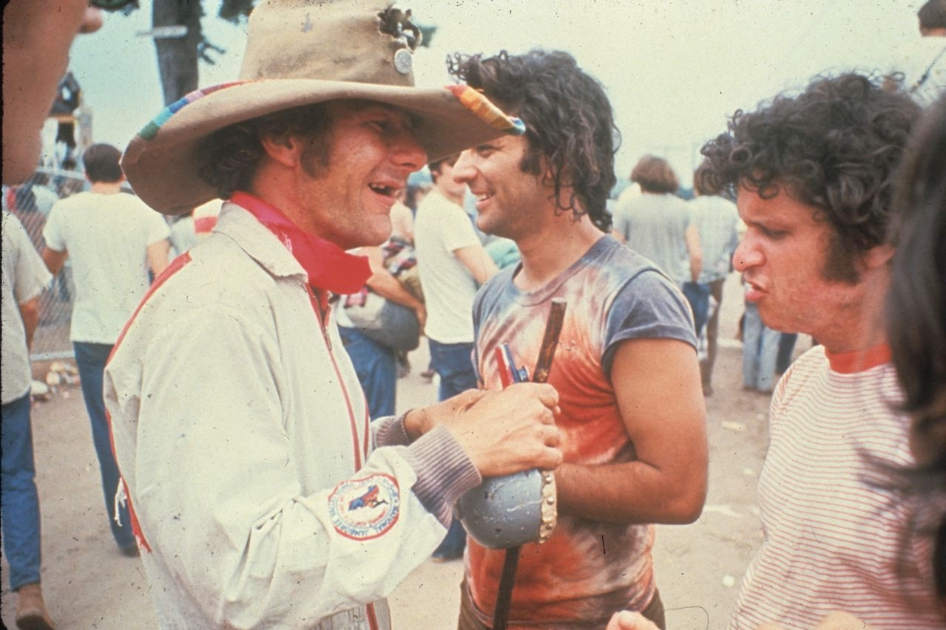
3 Days of Peace and Music…
Not enough food, water, or bathrooms
The Hog Farm
NM commune led by Wavy Gravy
Created “Please Force” because there was no security
Provided food to over 150,000 people

Slide 20
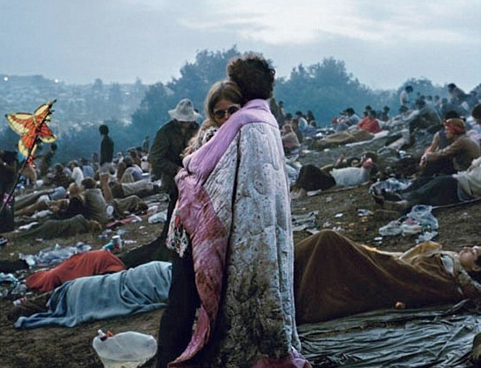
Woodstock

Slide 22
Jimi Hendrix

Slide 23
The Death of Woodstock
Notes:
Woodstock '94 was a music festival organized in order to commemorate the 25th anniversary of the original Woodstock Festival of 1969.
“Mudstock”
Woodstock ’99 attempted to emulate the original Woodstock Festival of 1969.
Ended with violence and rioting

Slide 24
Forever 27 Club
Notes:
Brian Jones – Rolling Stones

Slide 25
Death of the Counterculture
Declines by early 1970s
Causes of decline
Disillusion with drugs
Loss of counterculture icons
Charles Manson, Manson Family murders/Helter Skelter
Altamont Festival
Counterculture ideals included in mainstream society
Notes:
Drug use declines
No longer exciting
Addiction and deaths (Janis, Hendrix, Morrisson)
Charles Manson and the Manson Family:
Helter Skelter: His interpretation of the Beatles hit that outlined an impending race war
Ordered the murder of actress Sharon Tate and two friends at their home in the Hollywood Hills.
Altamont Speedway Free Festival: Intended to be “Woodstock West”
Marred by four deaths, as the Hell’s Angels were used as a security force.
The largest reason for the decline of the counterculture was the inclusion of many counterculture ideals into mainstream society.

Slide 26
Your own personal Woodstock
You will be creating a poster for your ideal music festival. This may be hand-drawn or digitally created.
Requirements:
3 days, with at least 5 acts each day.
A logo that can be used to promote the concert
A slogan that tells people the theme or mood of your concert (e.g. “Three Days of Peace and Music”)
Should be full color! 8.5”x11” at the minimum.

