Slide 1
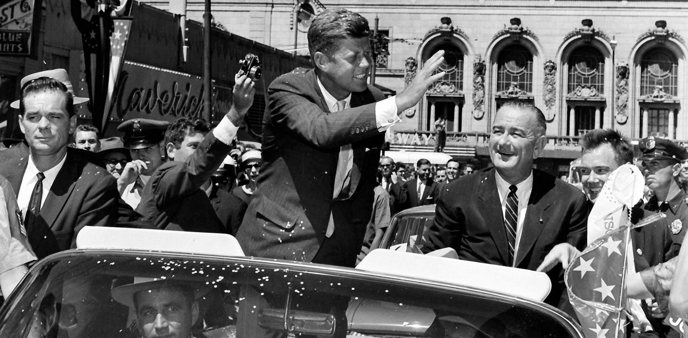
CAMELOT AND CRISIS

Slide 2
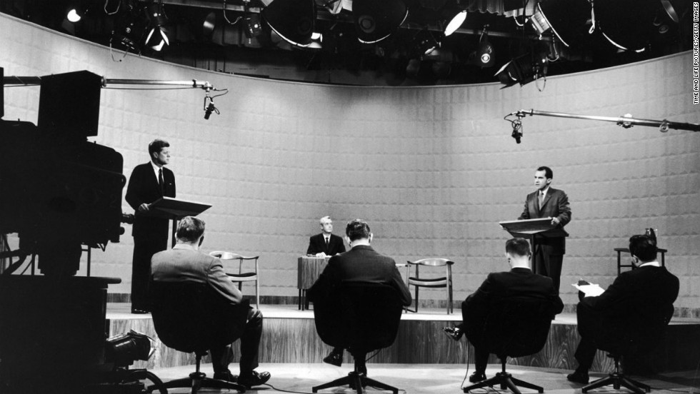
Election of 1960
Nixon vs. Kennedy
  Nixon: Experienced, but scandal
  Kennedy: Young, but Catholic
First televised presidential debate
  Turns focus to appearance
  Television campaign advertising
Notes:
Nixon
Incumbent VP under Eisenhower.
Emphasized his experience.
Wasted energy by campaigning in all 50 states instead of concentrating on the swing states.
JFK
Young Senator from Massachusetts.
Used his large, well-funded campaign organization to gain endorsements and get out the vote.
Battled discrimination from the media due to his Roman Catholic faith.
Debate
An estimated 70 million viewers watched the first debate.
Nixon had been sick recently, and looked pale, sickly, underweight, and tired. He also refused makeup for the first debate, and as a result his beard stubble showed prominently on the era's black-and-white TV screens.
Kennedy, by contrast, rested and prepared extensively beforehand, appearing tanned (due to recent campaigning in CA), confident, and relaxed during the debate.
Those who listened to the debate on the radio claimed Nixon had won, while those who viewed it on television believed Kennedy had won.

Slide 3
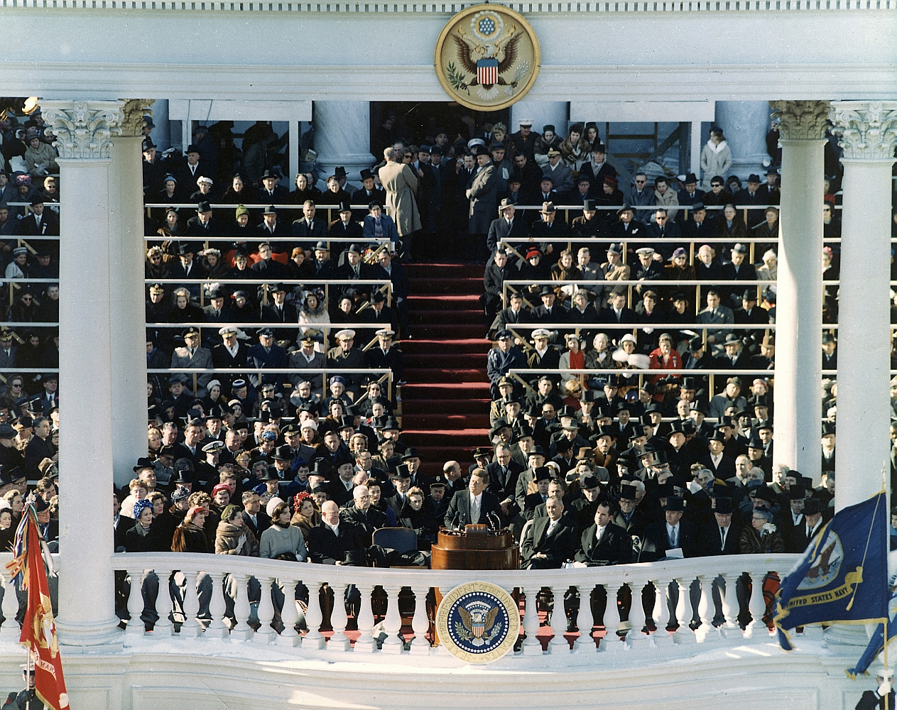

The “New Frontier”
Regular public service
Eradicate poverty
Environmental conservation
Cooperation with Latin America
Emphasis on manned space exploration
“Ask not what your country can do for you, but what you can do for your country.”
Notes:
First inaugural address delivered to a televised audience in color.

Slide 4
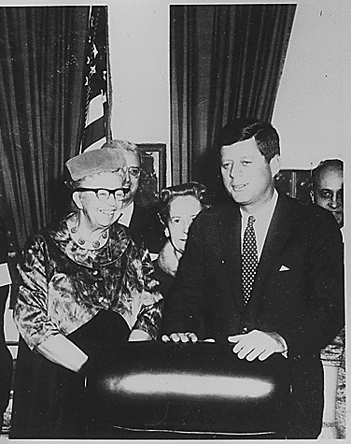
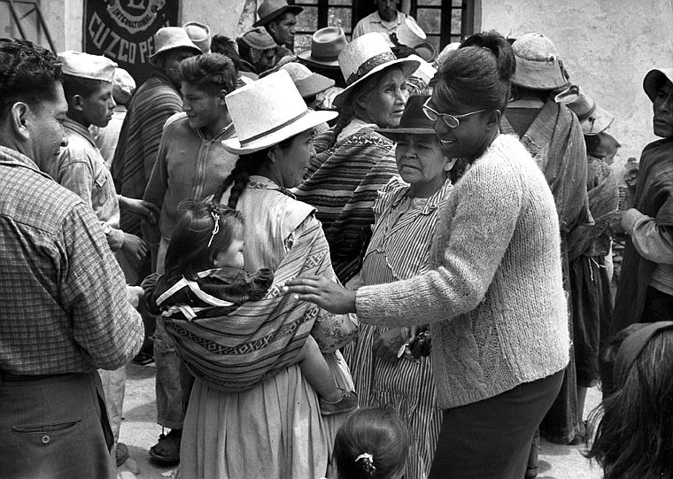
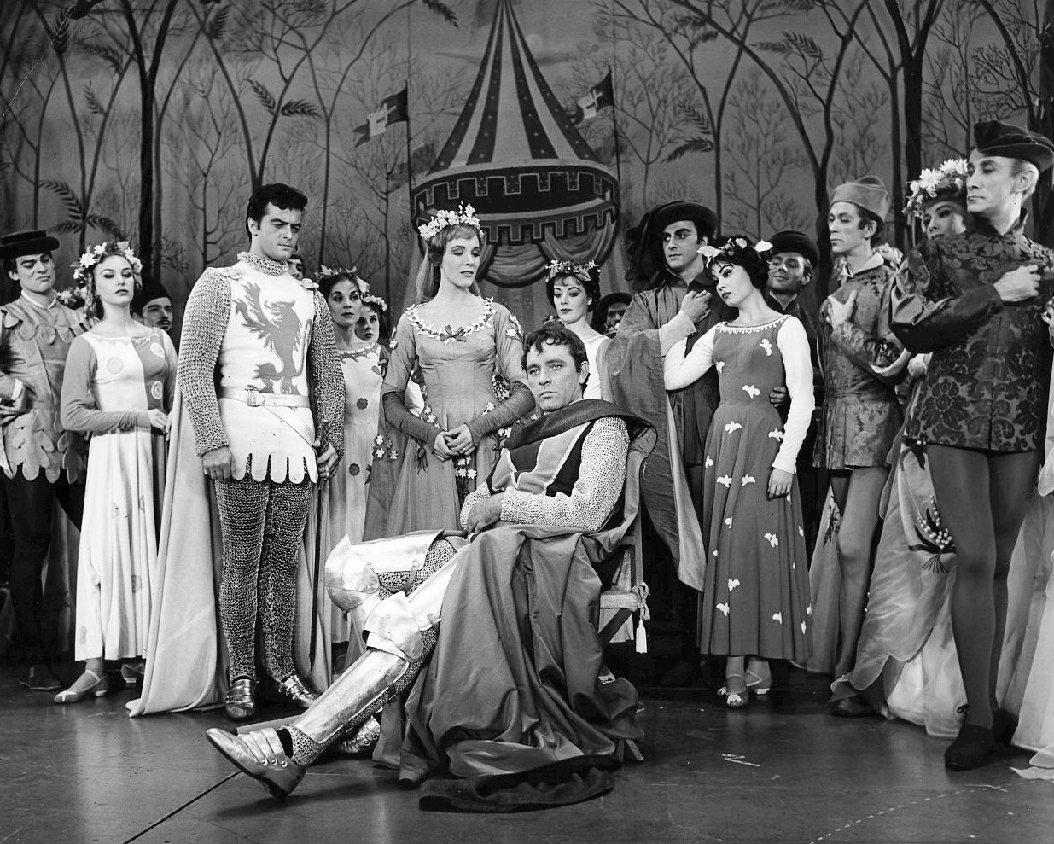
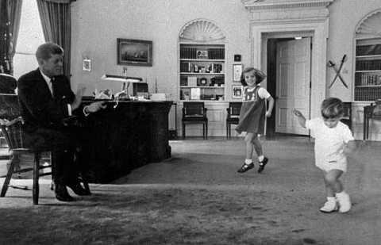
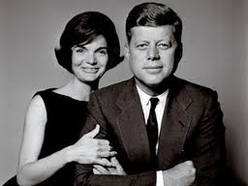
Kennedy’s Administration
“Camelot”
Presidential Commission on the Status of Women
Peace Corps

Slide 5
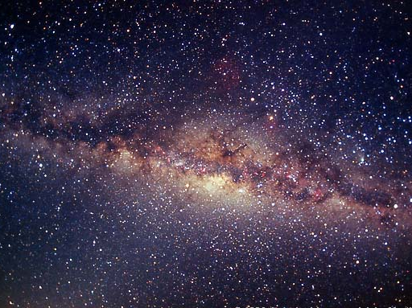
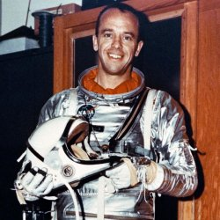
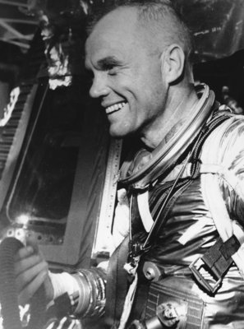
The Final Frontier
JFK challenges the nation to go to the moon
The Path to the Moon
  Alan Shepard – 1st American in space
  John Glenn – 1st American to orbit the Earth
Apollo Program: The NASA program aimed at landing a man on the moon
Notes:
In May of 1961, JFK challenged the nation to commit itself to landing a man on the moon within the decade.
Alan Shepard – 1st American in space
John Glenn – 1st American to orbit the Earth
Apollo Program: The NASA program aimed at landing a man on the moon.

Slide 6
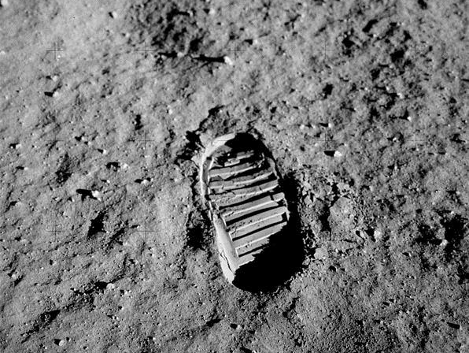
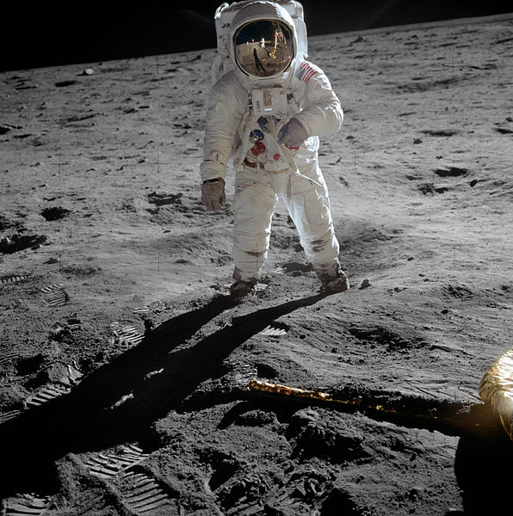
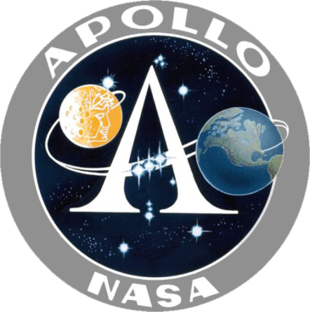
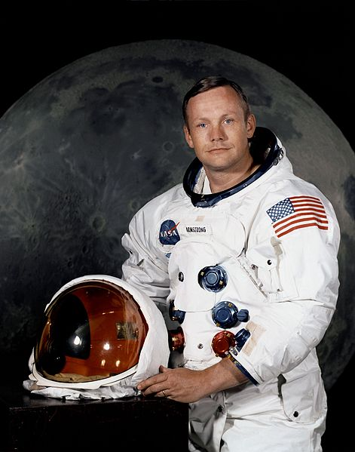
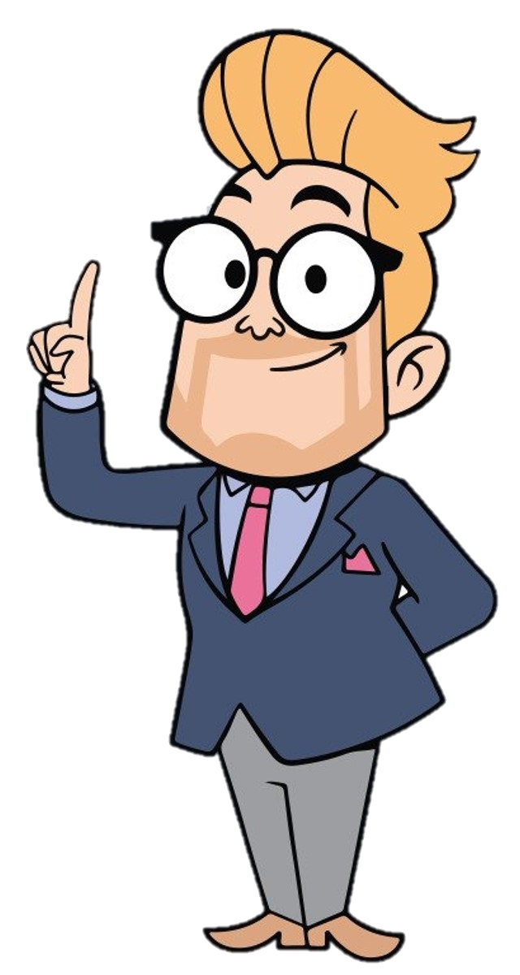
The Final Frontier
Apollo 11 - Neil Armstrong and Buzz Aldrin landed their Lunar Module on the Moon on July 20, 1969.
The moon landing was broadcast on television, and millions of people around the world witnessed the momentous event.
“That’s one small step for man… one giant leap for mankind.”

Slide 7
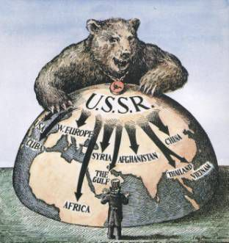
Containment in the Postcolonial World
New nations created after WWII due to powerful nationalist and anticolonial movements
Third world nations: Latin America, Asia, and Africa
  Economically poor and politically unstable
  Lacked education and technology
  Proxy wars by U.S. and USSR for influence
  Often supported repressive dictatorships (at least the country was stable)
Notes:
US deposes democratically elected shah of Iran after he seizes British oil property
CIA organizes coup in Guatemala against democratically elected nationalist leader Jacobo Arbenz Guzman after he seized land owned by the American United Fruit Co.
Would plan a coup in Cuba against Fidel Castro

Slide 8
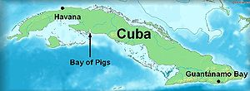
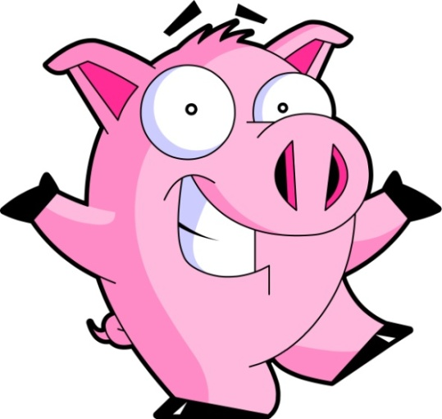
PROBLEMS IN CUBA
*No actual pigs were harmed in the making of this invasion.
Communist Revolution
  Led by Fidel Castro and Che Guevara
  Treaty of Friendship between Cuba and USSR
  Truman orders trade embargo
Bay of Pigs Invasion*
  Secret plan to overthrow Castro under Eisenhower
  Failed due to U.S. pulling air support at last minute
What could possibly go wrong?
Uh-oh.
Notes:
U.S. backed unpopular dictator Fulgencio Bautista
Overthrown by Communist leader, Fidel Castro.
Suspended elections, jailed or executed opponents, and censored press and media.
Took over U.S. owned sugar mills and refineries
President Eisenhower orders a trade embargo

Slide 9
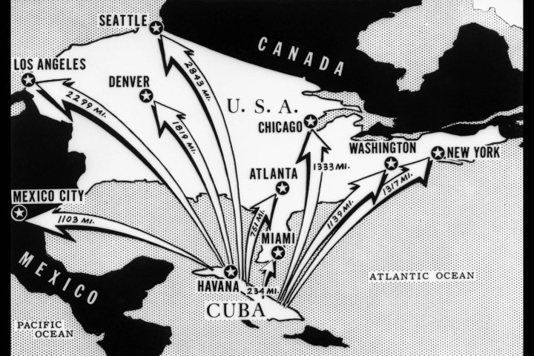
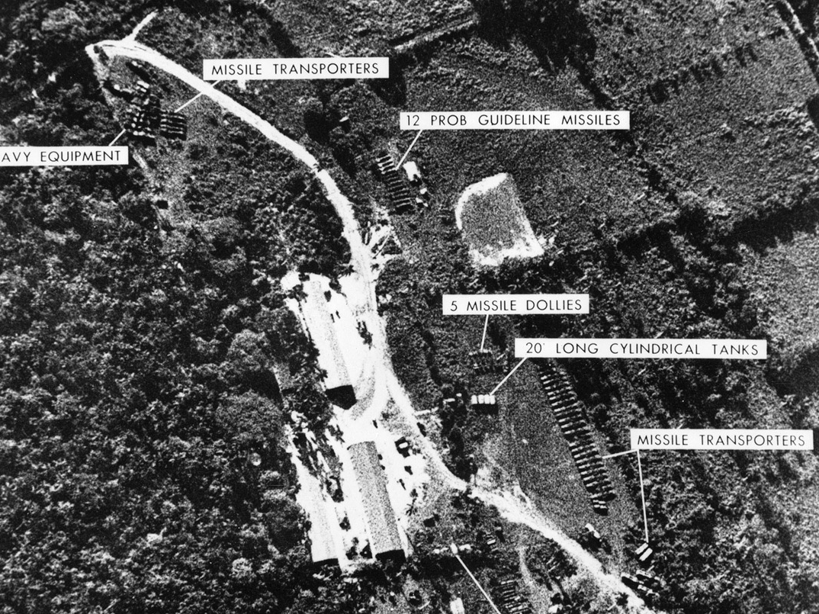
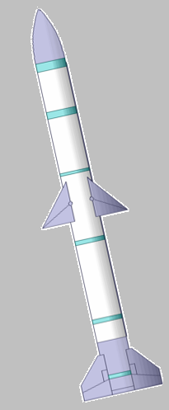
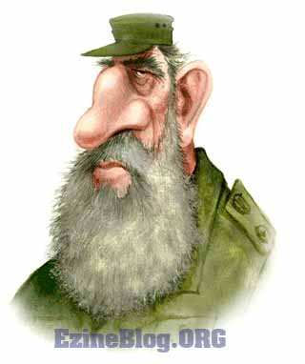
Cuban Missile Crisis
Missiles? What missiles?
Notes:
Nuclear missile sites are discovered on the island of Cuba by an American spy plane
Provided for by the USSR for “defense against aggressor nations”
Some missiles were fully operational, and were pointed at the United States.

Slide 10

You are advising President Kennedy. What do you do about the growing danger in Cuba?
Do nothing: American vulnerability to Soviet missiles was not new. America was still more powerful than Cuba.
Diplomacy: Use diplomatic pressure to get the Soviet Union to remove the missiles.
Warning: Send a message to Castro to warn him of the grave danger he, and Cuba were in.
Blockade: Use the US Navy to block any missiles from arriving in Cuba.
Air strike: Use the US Air Force to attack all known missile sites.
Invasion: Full force invasion of Cuba and overthrow of Castro.
Notes:
Have the students decide which option they’d choose. If you would like, have each group congregate in a different part of the room, discuss their reasons why they chose that option, and then share the options with the class. You can then go over some of the potential pros/cons of each decision. The next slide will explain why Kennedy decided on a blockade.

Slide 11
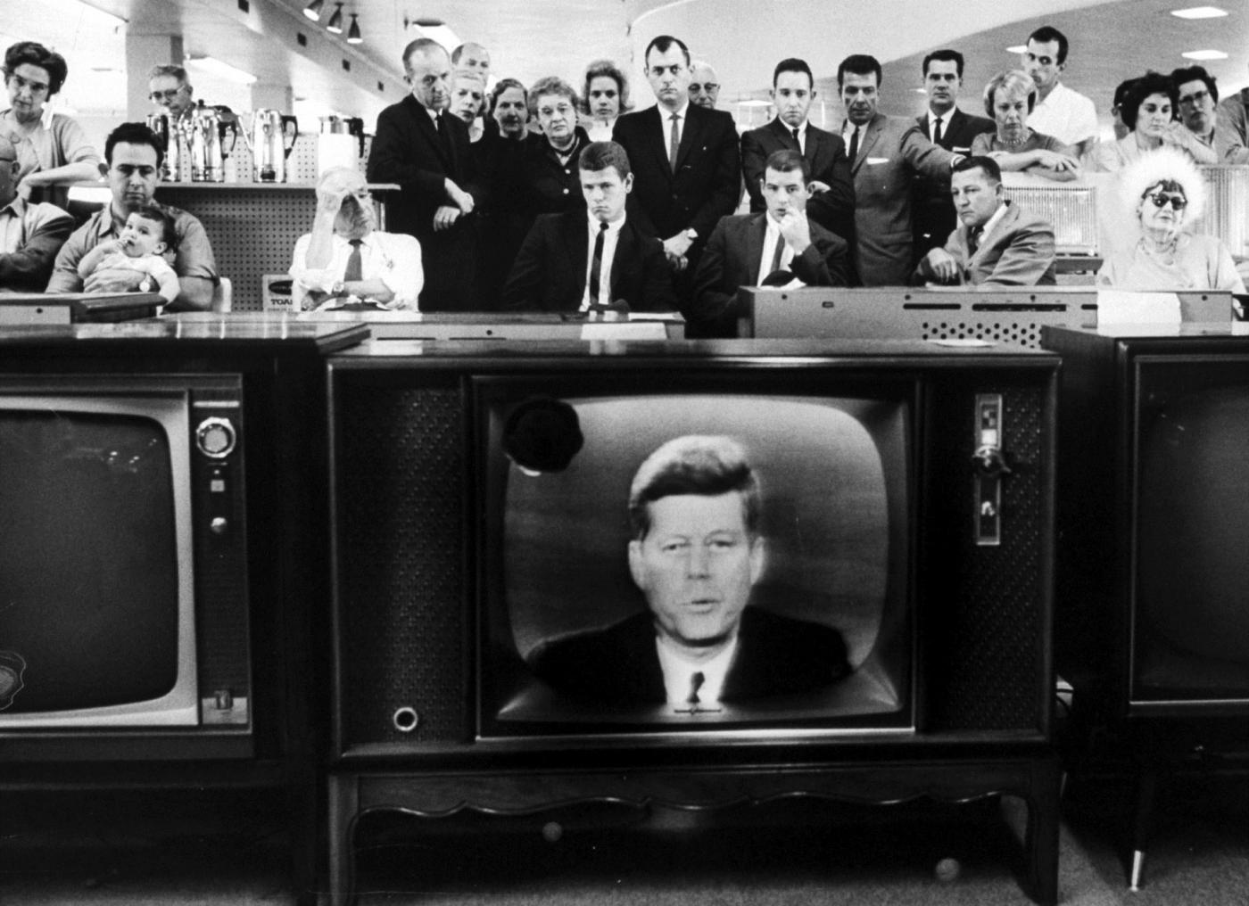
The Cuban Missile Crisis
JFK forms a blockade around Cuba
Goes on air to inform the public and issue a warning to the USSR
“It shall be the policy of this nation to regard any nuclear missile launched from Cuba against any nation in the Western Hemisphere as an attack by the Soviet Union on the United States, requiring a full retaliatory response upon the Soviet Union”
Notes:
“It shall be the policy of this nation to regard any nuclear missile launched from Cuba against any nation in the Western Hemisphere as an attack by the Soviet Union on the United States, requiring a full retaliatory response upon the Soviet Union”
DEFCON 2: (Air Force made ready for air strikes and nuclear interception on 15 minutes' notice)
Kennedy agrees to remove all missiles set in southern Italy and in Turkey, in exchange for Khrushchev removing all missiles in Cuba.

Slide 12
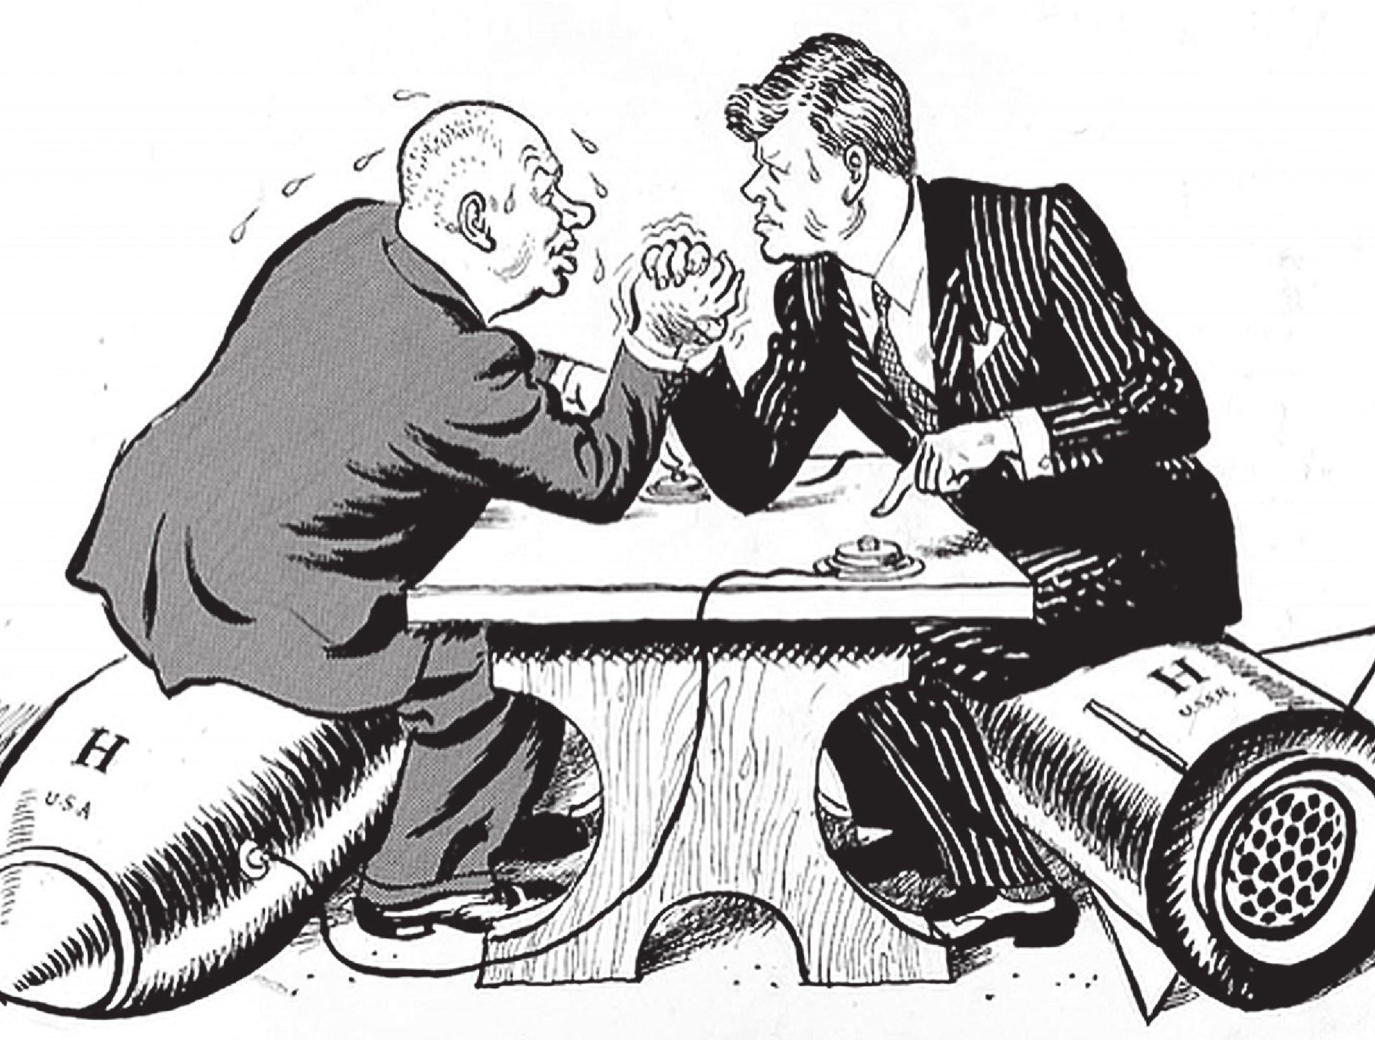
Effects of the Cuban Missile Crisis
“Eye to eye, they blinked first”
  Nearly avoid nuclear warfare
  Damages Khrushchev's credibility
Limited Test Ban Treaty: Prohibited testing nuclear weapons in outer space, underwater, or in the atmosphere
Notes:
On August 5, 1963, representatives of the United States, Soviet Union and Great Britain signed the Limited Nuclear Test Ban Treaty, which prohibited the testing of nuclear weapons in outer space, underwater or in the atmosphere. The treaty, which President John F. Kennedy signed less than three months before his assassination, was hailed as an important first step toward the control of nuclear weapons.
Discussions between the United States and the Soviet Union concerning a ban on nuclear testing began in the mid-1950s. Officials from both nations came to believe that the nuclear arms race was reaching a dangerous level. In addition, public protest against the atmospheric testing of nuclear weapons was gaining strength. Nevertheless, talks between the two nations (later joined by Great Britain) dragged on for years, usually collapsing when the issue of verification was raised.

Slide 13
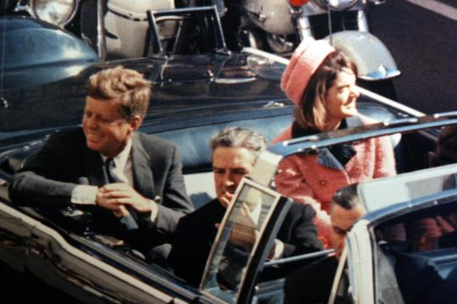
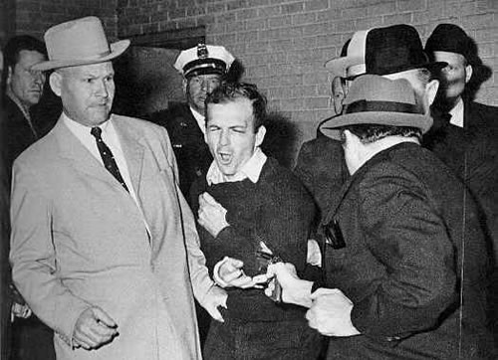
November 22, 1963
JFK assassinated by Lee Harvey Oswald while campaigning in Dallas, TX
Two days later, Oswald was himself shot and killed by businessman Jack Ruby.

Slide 14
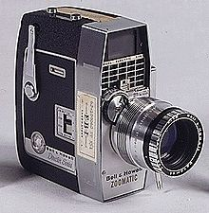
The Zapruder Film
Abraham Zapruder unexpectedly captured the assassination of the President with a home-movie camera. It is the only complete film of the event.
Notes:
The film camera is linked to the actual Zapruder film. It’s 33 seconds long, and clearly shows him being shot. Show it if you feel comfortable and that the class can handle it. The still shot of JFK and Jackie is linked to a documentary that debunks one of the largest conspiracy theories about the assassination, using digital imaging. That clip is about 10 minutes long. Show as much or as little as you want.

Slide 15
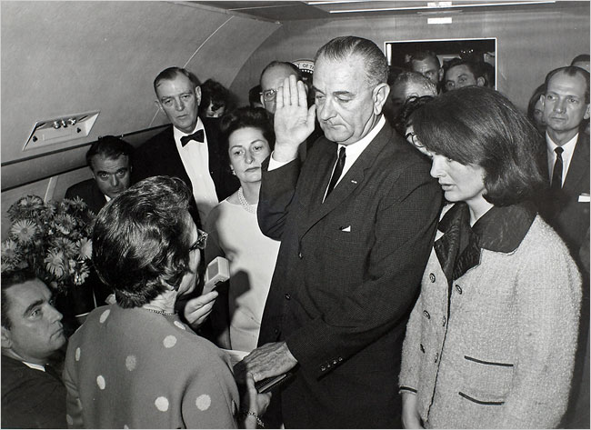
The Warren Commission
Created specifically to investigate the assassination of President Kennedy and Lee Harvey Oswald
  Still controversial, with inconsistencies and oversights becoming the obsession of conspiracy theorists
Johnson is sworn in on Air Force One right after JFK’s body arrives from the hospital.

Slide 16
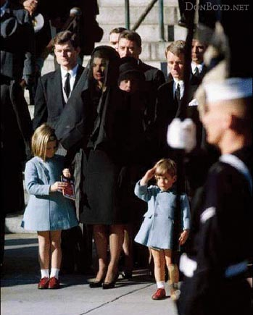
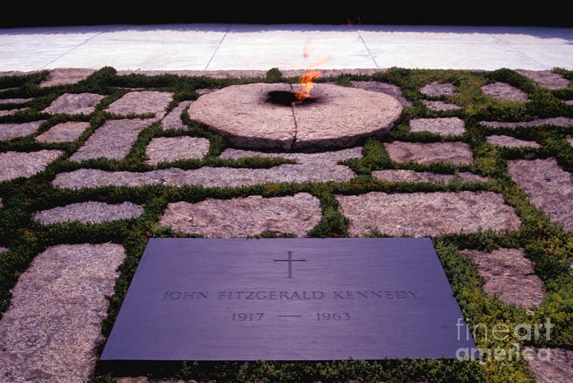
JFK’s Funeral
Eternal Flame at Arlington

